Slide 1
Module 8:
Storage and Pre-planning Considerations
Notes:
Module Time: 20 minutes/ 30 minutes
Materials:
Activity 8.1 and 8.2
Worksheet 8.2
Emergency Response Considerations video – (Show the video segment from 17:50 to 22:24)

Slide 2
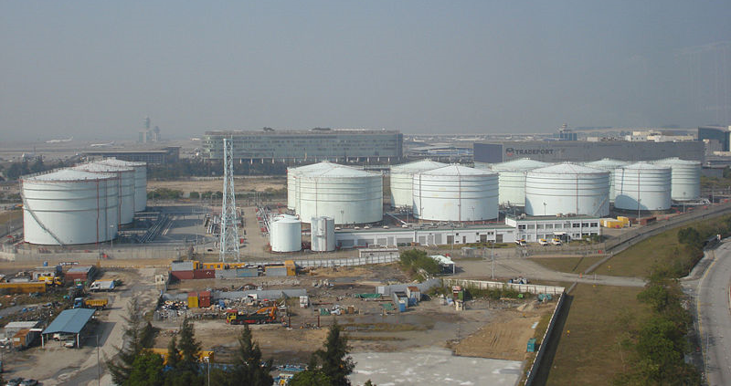
Objective
Upon the completion of this module, participants should be able to develop plans to fight or contain fires at tank farms & bulk storage facilities.
Notes:
Enabling Objectives
1. List the major concerns associated with fighting fires at tank farm and bulk storage facilities.
2. Describe the components of pre-planning.
3. Develop methods to mitigate each of the concerns associated with fighting fires at tank farms and bulk storage facilities.

Slide 3
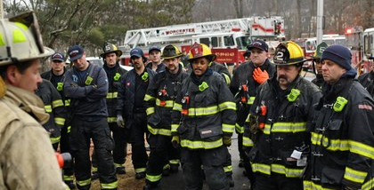
Introduction
Agency responsibility
Establish pre-plans, drills, & walk-throughs on regular basis
Establish & maintain good relations & cooperation with facility operators & staff
Pre-planning should identify:
Foam supplies
Special equipment
Apparatus
Mutual aid & contract services
Best defense is a pro-active approach and prevention!
Notes:
Show the video Emergency Response Considerations (17:50 to 22:24).
Tank farm and bulk storage fire operations can be extremely dangerous and require an extremely advanced technical knowledge of flammable liquids firefighting and fire protection. Because of the amount of time to set up operations and contain such a fire and the number of resources necessary to handle an incident and defend against a re-flash or re-ignition, they can become very tedious operations.
It is imperative the departments have good relations and cooperation with the facility operators and staff and should establish extensive pre-fire plans and schedule drills and walk-throughs on a regular basis. In most cases it will require additional special equipment and apparatuses for these facilities.
In many cases a major fire incident at one of these facilities will be beyond the capabilities of the department, therefore it is important to have relationships with sources of mutual aid and contract services. It may be prudent to contract outside services for these incidents depending on magnitude and location. The best single avenue of defense for these installations is prevention.

Slide 4
Bulk Storage Fire Operations
Considerations:
Pre-plans with predetermined response plans should be developed for emergency incidents
Fire foam flow rates should be established before incident occurs & reviewed regularly
Storage tanks containing ethanol-blended fuels should be identified & known by agency personnel in advance
Notes:
The following are some considerations for fire incidents at major facilities:
Pre-fire plans with predetermined flow rates should be established and reviewed regularly. Mutual aid and second-in companies should also be included in planning and drills. We also recommend that your pre-plan includes neighbors and how any incident could impact them.
Fire foam flow rates should be established before the incident occurs and reviewed regularly.
Storage tanks containing ethanol-blended fuels should be identified and known by the fire department personnel well in advance of any incident.

Slide 5
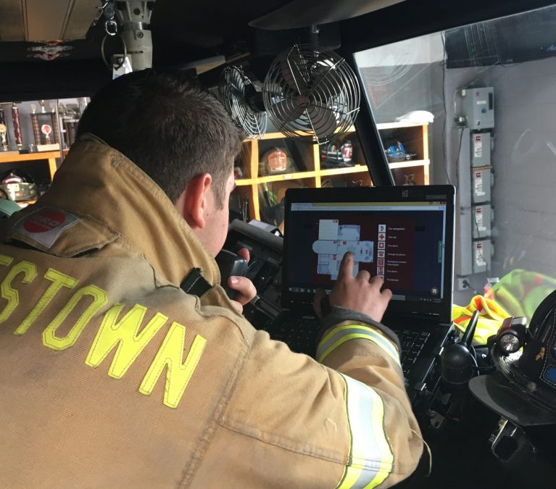
Bulk Storage Fire Operations
Considerations:
Connection locations & required pressures & flows identified on tanks provided with pre-piped foam systems
Fires in storage tanks where no fixed systems are available/ usable or in cases where fixed systems rendered inoperable may not be extinguishable with non-fixed appliances
Notes:
The following are some considerations for fire incidents at major facilities:
If tanks are provided with pre-piped foam systems, connection locations and required pressures and flows should be identified. Personnel should be aware of the potential danger that systems installed on tanks that previously contained regular gasoline may not work or be appropriate for ethanol-blended fuels being stored in those tanks. Greater flow capacities may be required, and subsurface systems do not work with ethanol components.
Fires in storage tanks where no fixed systems are available or usable or in cases where fixed systems are rendered inoperable may not be extinguishable with non-fixed appliances. Lowering the fuel level and protecting exposures may be the only options for reducing the overall impact of the event.

Slide 6
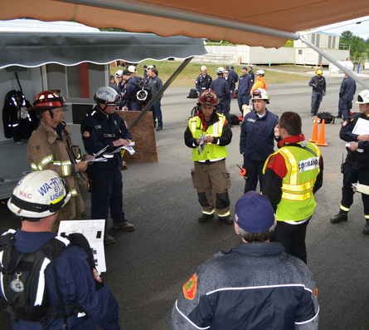
Pre-planning
Steps involved in the pre-planning process include:
Information gathering
Information analysis
Information distribution
Again, consider consortium approach for bulk AR-AFFF storage and availability
Ensure adequate foam resource management plan and foam stock rotation
Notes:
Pre-planning is a vital factor in the strategy of controlling an emergency situation. The amount of success obtained in resolving an emergency can, in most cases, be determined by the amount of advance preparation made by firefighting personnel. The purpose of pre-incident planning is to enable attack preparations and fire-fighting operations to be carried out at the scene of an emergency as efficiently and effectively as possible. The incident management attack operation can begin more quickly if details about the incident site are known prior to the arrival of the firefighters and if positions of equipment and possible hose layouts have been predetermined. When effective pre-incident plans have been made, less time needs to be spent on making decisions concerning the incident site during and after the size-up process.
Group Discussion:
Ask participants to list items they would look for when conducting an exterior survey at a tank farm or bulk storage facility. Answers should include:
Facility dimensions
Fire hydrant locations
Fire Department Connection (FDC) locations
Utility shut-offs
Fences
Power lines locations and sizes of tanks or other storage containers
Landscaping
Obstructions
Exposures
Doors, windows, and fire escapes
Steps involved in the pre-planning process include:
Information gathering: Collecting pertinent information at the selected site that might impact incident management operations, such as construction features, exposures, utility disconnects, fire hydrant location, water main sizes, and anything else that would impact response operations if an emergency should occur.
Information analysis: The information gathered must be analyzed in terms of what is pertinent and vital to incident suppression operations. An operable pre-incident plan must then be formulated and put into a usable format that can be used at the incident site.
Information distribution: All parties that will help to solve the problem should receive copies of the plan so they become familiar with both the plan and pertinent factors relating to it.
It may not be feasible to keep adequate foam stock on hand. It is important to consider a consortium approach for bulk AR-AFFF storage and availability. It is also important to ensure there is an adequate foam resource management plan and foam stock rotation.

Slide 7
Summary
Better positioned to respond if prepared in advance
Incident plan in place & maintain good relationships with agencies that can offer support in time of crisis
Drills/ walk-throughs essential & should be conducted on regular basis
Sometimes all that can safely be done is contain incident & let fire run course
Knowing when to let this happen is an important component of safety
Notes:
In the event of a major incident at a fuel storage facility, you will be better positioned to respond if you have done your homework in advance. You should have an incident plan in place and be in the habit of maintaining good relationships with the agencies that can offer support in your time of crisis. Drills and walk-throughs are essential parts of planning for major incidents and should be conducted on a regular basis.
A final note: Sometimes all you can safely do is contain the incident and let the fire run its course. Knowing when to let this happen is an important component of safety. Knowing the limitations of your resources and personnel, protecting the safety and wellbeing of your community all play a role in your emergency response decisions.

Slide 8
Activity 8.1: Ethanol Emergency Procedures
Purpose:
To allow participants to utilize all the information discussed in the course to determine the appropriate procedures for fire & non-fire ethanol emergencies
Notes:
Time: 15 minutes
Materials: None
Instructor Directions:
Allow the participants to work in groups of two to three for this activity.
Assign either scenario #1 or #2 to each group.
Participants should determine appropriate procedures based on their scenario.
After 10 minutes call time and randomly call on groups to provide their answers.
Participants should mention the following:
Methods to identify the product;
What potential dangers need to be considered based on the chemical and physical properties of the Ethanol Flex-Fuel;
Establishing a safety zone;
Spill containment;
Environmental issues;
Fire suppression methods, techniques, and considerations; and
Cleanup considerations.
Scenario #1
A transport vehicle carrying 8,500 gallons of Ethanol Flex-Fuel to a retailer is involved in an accident at an intersection. A passenger car ran a red light hitting the trailer in the side rupturing one tank holding 3,200 gallons of Ethanol Flex-Fuel and causing the fuel to leak from the trailer. The fuel is running downhill into a creek which runs next to the street toward an entrance to a shopping center.
Scenario #2
A transport vehicle carrying 8,500 gallons of Ethanol Flex-Fuel to a retailer is involved in an accident at an intersection. A passenger car ran a red light hitting the trailer in the side rupturing one tank holding 3,200 gallons of Ethanol Flex-Fuel and causing the fuel to leak from the trailer. The fuel is running downhill into a dry ditch which runs next to the street toward an entrance to a shopping center. After approximately 12 minutes the spilled fuel on the ground near the cargo tank truck catches fire.

Slide 9
Activity 8.2: Ethanol Incident Procedures
Purpose:
To allow participants to show comprehension of the firefighting foam capabilities and inabilities to combat polar solvent fire emergencies
Notes:
Time: 15 minutes
Materials: Worksheet 8.2
Instructor Note:
Using the video Responding to Ethanol Incidents, show the segment from 10:50 to 13:53. After the clip ask the following questions:
In the table-top demonstration, why were most of the foams ineffective on polar solvent fuels?
Answer: Because ethyl alcohol and water mix together and foam bubbles are mostly water.
What was in the two Alcohol-Resistant (AR) foams that allowed them to create the foam blanket?
Answer: Polymers
Why is dilution with water not an effective mitigation technique for polar solvent fires?
Answer: Even at 5:1 ratio/ 500% dilution ethanol will still burn.
Instructor Directions:
1. Have participants attempt to properly order the steps in the following procedures.
2. Participants can work individually or in groups.
3. After the participants have put the procedures in order, go over the correct order and then
discuss the rationales behind each.
Answers:
B
D
E
C
A
F
Ask participants what emergency personnel, in addition to cleanup personnel, they would like to have on stand-by as they conduct their cleanups. Why?

