Slide 1
Module 7:
General Health and Safety Considerations
Notes:
Module Time: 30 minutes/ 55 minutes
Materials:
Activity 7.1
Worksheet 7.1
Emergency Response Considerations video – (Show the video segment from 15:42 to 17:50)

Slide 2
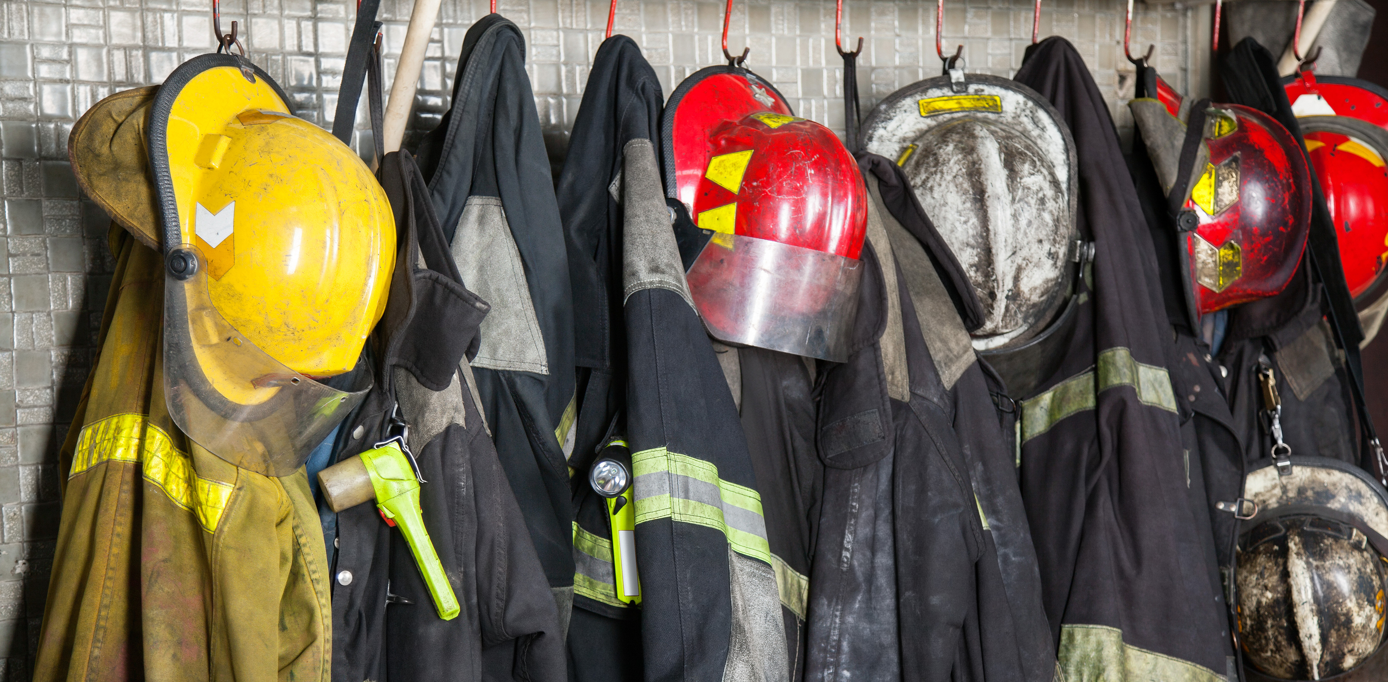
Objective
Upon the completion of this module, participants should be able to determine the potential spill control methods, proper personal protective equipment (PPE), & detection & monitoring devices for responding to ethanol-blended fuel incidents.
Notes:
Enabling Objectives
1. Discuss the possible combinations of fuel/ ethanol-blended fuel spills.
2. Determine the tools/ personnel/ steps necessary to clean up spills of various fuels.

Slide 3
Introduction
Understanding the properties & characteristics
E10 retains hydrocarbon/ gasoline characteristics
Absorbents/ booms that are designed to pick up oil-type substances are effective
Blends with greater than 10% ethanol start to take on polar solvent characteristics
Absorbents/ booms designed for polar solvents should be used
When water is introduced, phase separation of the water/ ethanol solution may take place
Notes:
Show the video Emergency Response Considerations (15:42 to 17:50).
Group Discussion:
The video previously mentioned that dilution with water was not an effective tactic for ethanol and ethanol-fuel blend fires. Why is this true?
Answer: Ethanol diluted up to 500% (5:1 ratio) with water will still burn.
Understanding the properties and characteristics of both gasoline and ethanol will help emergency responders mitigate incidents involving ethanol-blended fuels. Gasoline blended with up to 10% ethanol will retain hydrocarbon fuel chemical characteristics. Blends with greater than 10% ethanol will start to take on polar solvent characteristics. Absorbents and booms that are designed to pick up oil-type substances will pick up the ethanol-blended fuel.
When water is introduced to a gasoline ethanol blend, phase separation may start to take place. Phase separation occurs after the fuel blend reaches the water saturation point. The water will then attract the ethanol and form a water/ ethanol solution in the bottom of the tank. In this situation, an oil-type boom or absorbent will pick up the remaining gasoline on top leaving the water/ ethanol solution.
https://www.youtube.com/watch?v=-o5D-nic9WM is a video of hydrocarbon and ethanol fuels burning.

Slide 4
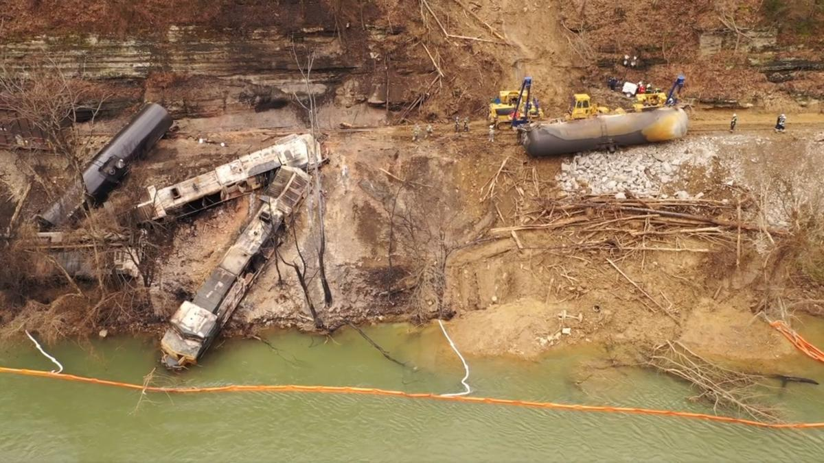
Fuel Spill Control
Land spills
Pads, absorbents, adsorbents
Dams, dikes, retention basins
Water spills
Damming
Diversions
Boom (specialized for petroleum)
Oil-type boom/ absorbent will pick up gasoline leaving water/ ethanol solution
Consult with Environmental Agency for further direction
Notes:
It is important to recognize the various types of spill control measures that may be needed in an emergency response. Different tactics will be needed for land spills versus water spills. It is also important to recognize what type of spill containment products will be needed.
It is important to notify the appropriate local, state and/ or Federal authorities having jurisdiction in the event of a spill.

Slide 5
Special Considerations
Keep in mind that if water absorbing booms and/ or absorbents are used to pick up ethanol/ water solutions, the absorbents may be flammable
If an AR foam blanket is used to control the vapors from ethanol-blended fuel, remember a portion of the foam solution will absorb into ethanol-blended fuel
Notes:
The water/ ethanol solution can be picked up with water absorbing boom or absorbent. Keep in mind that depending on the water-to-ethanol ratio, the solution may still be flammable.
Also remember that if foam is used to contain the ethanol-blended fuel vapor, a portion of the foam solution will absorb into the ethanol-blended fuel, forming a solution that sinks below the gasoline level. This solution again will have water/ ethanol properties, which will require a water-type boom or absorbent. The ethanol-blended fuel located just below the foam membrane will require an oil-type absorbent since the ethanol/ gasoline blend will still maintain hydrocarbon characteristics.

Slide 6
Control Zones
Contaminated area hightest level of PPE required
There are 3 control zones
Hot zone
Warm zone
Cold zone
Cold Zone
(Support Zone)
Warm Zone
(Contamination Reduction Zone)
Hot Zone
(Exclusion Zone)
Contamination reduction and transit area
Area for supportive actions
Notes:
Control zones are the areas established around a hazardous materials incident and indicate the safety level and degree of hazard in that particular zone. Control zones are initially established using the U.S. DOT Emergency Response Guidebook. There are three control zones that must be established: hot, warm, and cold.
The hot zone is located immediately around the release of a material. This area encompasses materials that are hazards. It is the area of greatest danger and contamination.
The warm zone is located immediately outside of the hot zone and is the area where decontamination takes place.
The cold zone begins where the warm zone ends. The command post, as well as other support functions, is located in the cold zone. Personal protective clothing in this area may be limited to safety equipment and normal working clothes.
After the control zones are established then detection and monitoring is used to refine and enhance those control zones. It is important to remember that control zones may be adjusted ad the incident changes.

Slide 7
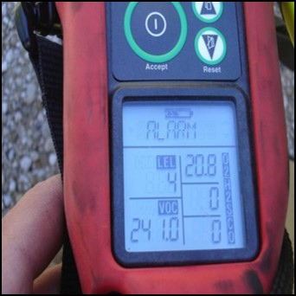
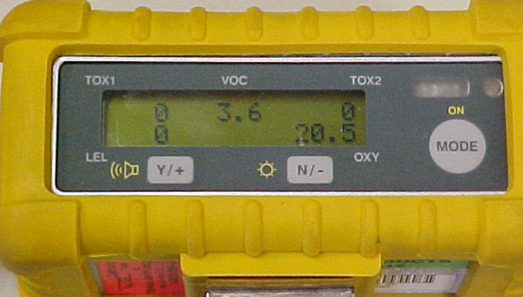
Detection & Monitoring
Should be performed at all ethanol-blended fuel incidents
Monitoring equipment is a crucial resource for responders during assessment & mitigation
Utilize a multi gas meter
LEL, CO, H₂S, O₂
Remember to consider conversion factors depending on calibration gas used for detector!
Consider two (2) multi-gas detectors as part of your monitoring group
Notes:
Detection and identification of hazardous materials using monitoring equipment is normally performed by responders at the technician/ specialist level. Monitoring equipment is a crucial resource for responders to use in the incident assessment and during mitigation, especially involving ethanol-blended fuels. Monitoring equipment will help responders determine the concentration levels of hazardous materials and make response decisions based on these readings. Utilizing a multi gas meter can detect LEL, CO, H₂S and O₂. Readings will help responders determine how best to protect themselves and others from the effects of the material and how far the public should be removed from the contaminated area.
The use of two (2) multi-gas detectors allows the responders to focus on each individual aspect of the ethanol-blended fuel incident. One responder focuses on hydrocarbon identification while the second responder focuses on ethanol identification. This practice minimizes confusion as to which vapor has been detected since current monitoring equipment is not capable of product identification.

Slide 8
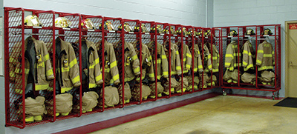
Personal Protective Equipment
Response to ethanol & ethanol-blended fuel incidents require PPE
Components of PPE include:
Helmet with face shield/ eye protection
Protective hood
Turnout coat
Turnout pants
Gloves
Boots
Respiratory protection
Notes:
Group Discussion:
Ask participants if they can list the health hazards of ethanol. Put them on a paper chart or white board. Typical hazards include:
Irritation to the eyes and skin
When inhaled or absorbed:
Produces central nervous system depression
Headaches
Nausea
Dizziness
Loss or balance or coordination
Stupor
Typical hazards include:
Inhalation:
Central nervous system depression
Irritation
Nausea
Vomiting
Long-term exposure:
Liver damage
Kidney damage
Ask participants what they consider the most important type of PPE when responding to ethanol emergencies including spills, releases, and fires.
Remind participants that we often think of the dangers of materials when they are involved in a fire, however, it is just as important to consider PPE and in particular respiratory protection for materials involved in spills and releases.
Remind participants that this is an awareness course on ethanol and ethanol-fuel blends. However, it is always critical to stress the importance of proper PPE. This course is not designed to provide instruction in the use or selection of PPE, but this section is presented as a reminder of its importance.
Ethanol and ethanol-blended fuel burns similarly to gasoline fires; therefore, it is critical that all responders wear appropriate firefighter PPE. Protective clothing is designed to protect the wearer from head to toe and has proven to reduce the severity of injuries as well as save the lives of many firefighters. The following components constitute a general set of firefighter PPE:
Helmet with either a face shield or eye protection
Protective hood
Turnout coat
Turnout pants
Gloves
Boots
Respiratory protection
Respiratory protection is especially critical since the respiratory system is the primary route of exposure into the body for hazardous chemicals. There are three types of respiratory protection:
Air-Purifying Respirators (APR) and Powered Air-Purifying Respirators (PAPR);
Supplied Air Respirators (SAR); and
Self-Contained Breathing Apparatus (SCBA)
Remember that all personnel responding to a spill or fire must wear and be trained in the use of the specific PPE required for a given emergency situation (see Figure 7.1 in the Participant Guide).

Slide 9
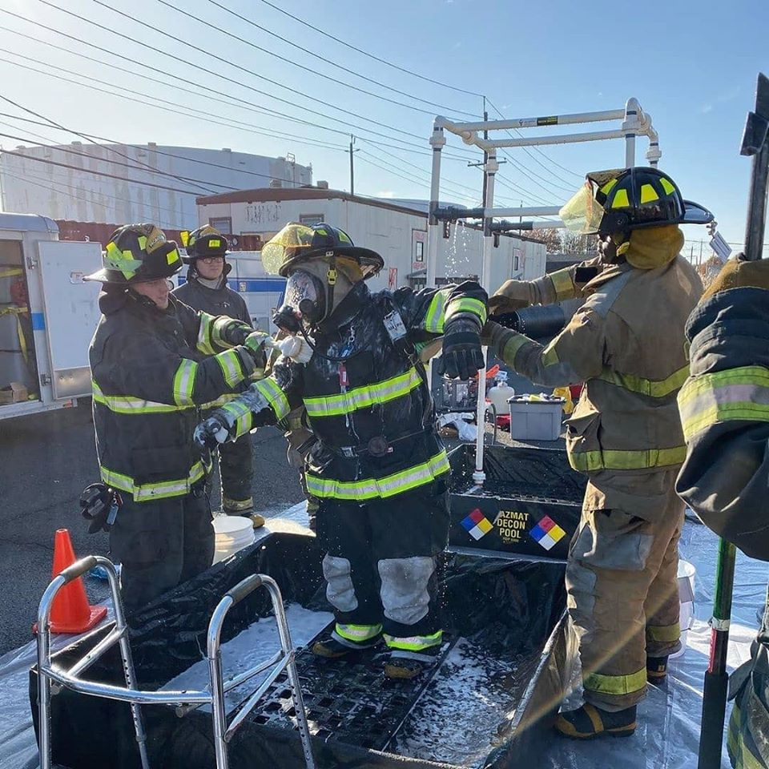
Decontamination Recommendations
Post response decontamination is required to prevent contamination outside the incident zones (secondary contamination)
Decontamination should include surfactant & water based cleaner
All decontamination runoff should be contained, properly tested & disposed of
Notes:
Post response decontamination is required to prevent contamination outside the incident zones (secondary contamination). Decontamination should include surfactant and water based cleaner. All decontamination runoff should be contained, properly tested and disposed of.

Slide 10
Summary
Procedures to ensure safe incident management for fire/ spill
Know type of fuel spilled/ burning essential to success of operation
Take steps to contain incident & appropriately distribute proper foam
Critical that all responders wear appropriate PPE
Notes:
Regardless of whether you are confronted with a spill or a fire, there are certain procedures that must be followed in order to ensure safe incident management. Knowing the type of fuel that has spilled or is burning is essential to the success of your operation. In addition, you should take steps to contain the event and appropriately distribute the proper foam. It is very critical that all emergency responders wear appropriate PPE when responding to emergencies involving ethanol-blended fuels.

Slide 11
Activity 7.1: Incident Procedures
Purpose:
To become familiar with the correct order of steps in the following procedures & the rationales behind them
Notes:
Time: 15 minutes
Materials: Worksheet 7.1
Instructor Directions:
1. Have participants attempt to properly order the steps in the following procedures.
2. Participants can work individually or in groups.
3. Use Worksheet 7.1.
4. After the participants have put the procedures in order, go over the correct order and then
discuss the rationales behind each.
Answers:
D
A
B
C

