Slide 1
Module 5:
Storage and Dispensing Locations
Notes:
Module Time: 40 minutes/ 55 minutes
Materials:
Activity 5.1
Worksheet 5.1
Emergency Response Considerations video – (Show the video segment from 9:31 to 12:13)

Slide 2
Objective
Upon completion of this module, participants should be able to discuss common locations for storage & dispensing of ethanol-blended fuels and will provide a basic understanding of these storage/ dispensing sites.
Notes:
Enabling Objectives
1. Describe the four common types of storage tanks at tank farm facilities.
2. List potential benefits and challenges associated with fixed fire suppression systems at fuel storage facilities.
3. Prepare a list of agencies that may be called upon for support during an event at a fuel storage or dispensing location.

Slide 3
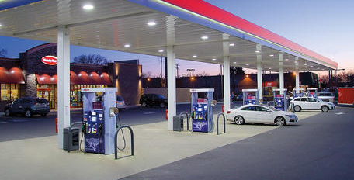
Introduction
Recognition of storage locations in the community:
Production facilities
Liquid product terminals
Transload facilities
Construction sites
Retail fueling stations
Notes:
Show the video Emergency Response Considerations (9:31 to 12:13).
Group Discussion:
Ask participants if they know how many ethanol plants there are in the United States.
Answer: For the most current information go to www.EthanolRFA.org.
Often when the response community thinks of storing and dispensing ethanol-blended fuels we fail to think of the retail fueling station on the corner. As a result, we can believe that if there is no bulk storage operation or production operation in our jurisdiction, we have little to worry about. This could not be further from the truth. Today nearly all gasoline in the United States is blended with some level of ethanol. Ethanol and ethanol-blended fuels are found at production facilities, bulk tank farms, rail transload facilities, construction sites and retail fueling stations within your community and throughout the country. It is important for local fire departments to be familiar with the facilities in their locations.

Slide 4
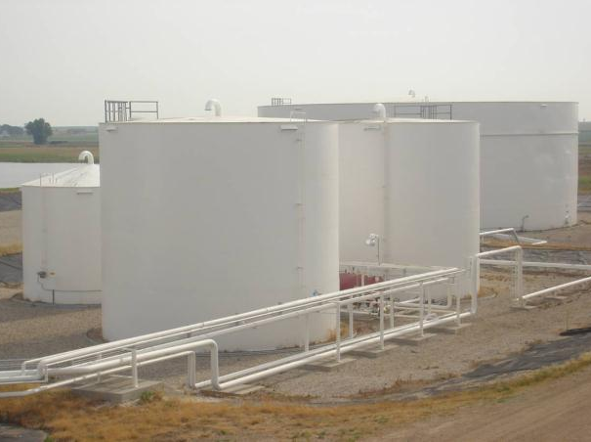
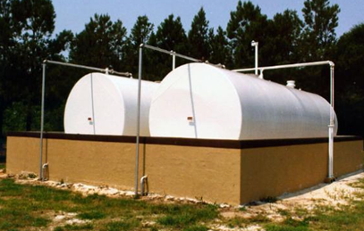
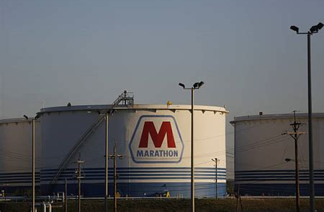
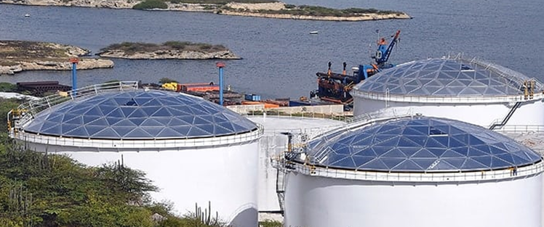
Storage Tank Types
Notes:
Any large volume of denatured fuel ethanol will typically be stored in conventional carbon steel storage tanks, such as those that are suitable for gasoline and other flammable fuels. Denatured fuel ethanol can also be stored in stainless steel storage tanks, these tanks are less common. Yet as consumption increases, larger ethanol tanks will become increasingly prevalent. These storage tanks should be identified by markings corresponding with the fuel stored.
There are several types of above ground atmospheric storage tanks typically found at bulk storage facilities. The more common bulk storage tanks for ethanol-blended fuels are noted below.
• Cone roof and dome roof tanks
• Open top floating roof tanks
• Covered floating roof tanks including geodesic domes
• Horizontal Storage Tanks
Lastly, please note that as a type of storage tank, spherical tanks do exist for bulk storage. To date this type of tank design has been limited to petrochemicals, flammable liquids or gases normally stored under pressure. Currently there are no known use of these tanks for storage of ethanol blended fuels. However, the industry is evolving at a rapid pace and the use of these tanks for ethanol-blended fuels could become a reality. It is incumbent upon any and all organizations and agencies that have statutory responsibilities or functional capabilities to become familiar with bulk storage and ethanol production facilities, determine what is the nature and type of bulk storage tanks being used and develop detailed pre-plans.

Slide 5
Storage Tank Design
Typically stored in conventional carbon steel storage tanks
May be smaller than other tanks at terminal
4 general types of storage tanks:
Horizontal storage tanks (above and below ground), possibly with built in containment systems
Cone roof (closed-top) tanks
External floating roof (EFR) tanks have open top with a floating pan
Internal floating roof (IFR) tanks with closed top & internal floating pan (most common storage type for denatured fuel ethanol)
IFR tanks may also have been retro-fitted from EFR with a geodesic dome type design instead of a conventional carbon steel metal roof and may be used for storage of ethanol-blended fuels
Notes:
There are four general types of storage tanks at tank farm facilities: cone roof (closed-top) tanks, external floating roof (EFR) tanks which have an open top with a floating pan, and internal floating roof (IFR) tanks (see Figure 5.1 in the Participant Guide), with a closed top and an internal floating pan and horizontal storage tanks. The majority of existing EFR tanks have been converted to IFR in recent years. Denatured fuel ethanol will typically be stored in one of these IFR tanks.
Dome roof (geodesic) retrofitting over open floating roof tanks has been taking place within the U.S. over the decade or more to address regulatory requirements, vapor control and product integrity. This type of bulk storage tank may contain ethanol-blended fuel.
Horizontal tanks may be found and used for ethanol-blended fuels in bulk storage facilities, retail markets, agriculture applications and private residences where regulatory codes allow.

Slide 6
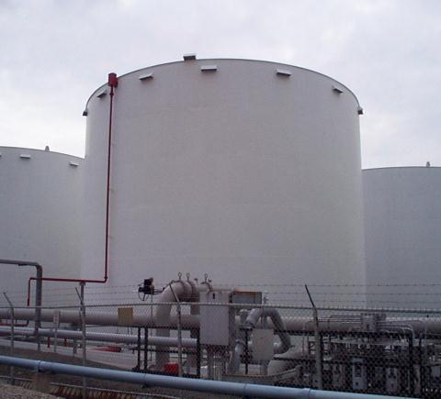
Storage Tank Design
Internal floating roof (IFR) tanks:
Closed roof
Internal floating pan
Eyebrow venting
Fire protection
Notes:
The most common denatured fuel ethanol bulk storage tanks are internal floating roof tanks. Key characteristics to look for on internal floating roof tanks are: closed roof, internal floating pan, eyebrow venting, and fire protection system.

Slide 7
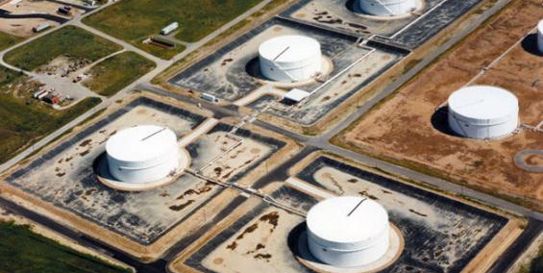
Spill Containment
Spill containment dikes usually designed to contain largest tank within the contained area
Notes:
Spill containment dikes are required to contain the volume of the largest tank plus rainfall within the contained area. Additional fluid from a fire fighting operation could lead to overfilling/ breaching of the dike.
As a side note, large, horizontal tanks that are elevated do not fall under the same regulatory requirements for containment. These are much more common at smaller distribution facilities and in agricultural settings.

Slide 8
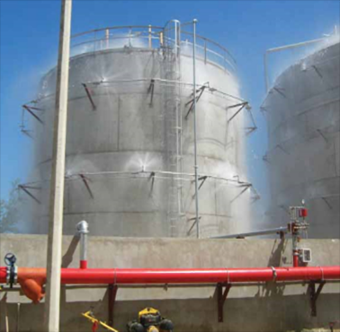
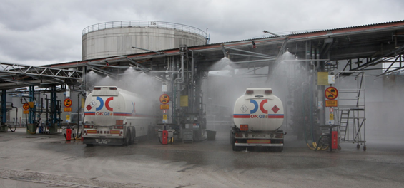
Fire Protection Systems
Fixed (Built-in) fire protection systems:
Can deliver water, foam or a combination of extinguishing media
Combination of components permanently installed
Can be activated manually &/ or by detection device
Fire protection systems should meet current industry standards & codes
Notes:
Some storage tanks have fixed (built-in) fire protection systems. Fixed systems are a combination of components including foam concentrate storage, proportioning valves, and delivery devices that are permanently installed to provide fire suppression protection. These same fixed systems can service multiple storage tanks, manifolds, and loading/ unloading racks.
The systems can be activated manually or by a detection device. Topside application foam systems may require much higher application rates for ethanol-blended fuels than for previously stored fuels. Subsurface injection systems may not work at all with ethanol-blended fuels.
Fire department personnel should be working closely with terminal operators to keep abreast of changes in fuel storage at liquid product terminals.
It is important to ensure the fire protection systems are meeting current industry standards and codes. It is also important that emergency responders know how to activate the fire protective systems at a liquid product terminal.

Slide 9
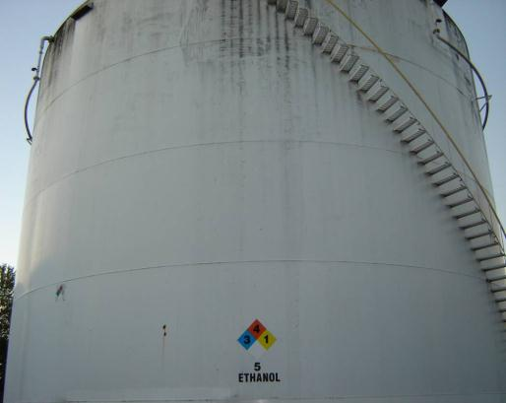
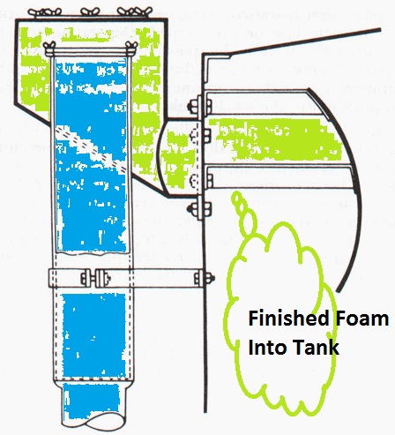
Built in Fire Protection Systems
Biological growth
Fixed foam system
Fixed foam system
Notes:
The illustration is an example of showing built-in Type I fixed or Type II semi-fixed fire protection system on a bulk storage tank containing ethanol.
In this photograph it is worth noting the biological growth on the side of the bulk storage tank. The exterior of the storage tank “sweats” more profoundly when significant amounts of high concentration ethanol blends are present during warmer temperatures. This moisture captures the organic particulates in the atmosphere and ultimately leads to an algae like growth on the sides of the tank. There will also be biological growth around the eyebrow vents at the top of the tank in Internal Floating Roofs (IFRs).
*Also note the NFPA 704 placard indicating the tank’s contents.

Slide 10
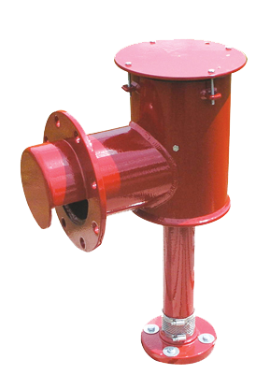
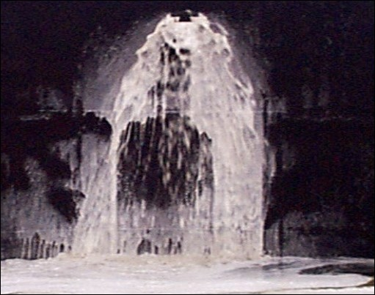
Foam Deflector Device
Notes:
The foam deflector device is attached to most Type II fixed foam chamber discharge outlets. The deflector directs foam down and over a large area of the inside of the tank wall and onto the top of the burning liquid inside of the tank. Before fire/ foam attack can begin on a tank, responders need to calculate available space within the tank. Working with facility operators to calculate the available space in gallons will allow responders to know if the product needs to be removed from the tank before operations can begin or allowed to burn off to reduce product in tank. Fire operations have to account for finished foam going into the tank so as to not overflow contents. Expansion needs to be taken into consideration. This would be the ratio of volume of foam formed to the volume of solution used to generate the foam. For example, an eight expansion means 800 gallons of foam from 100 gallons of solution. Keep in mind foam drain time will continue throughout operation.

Slide 11
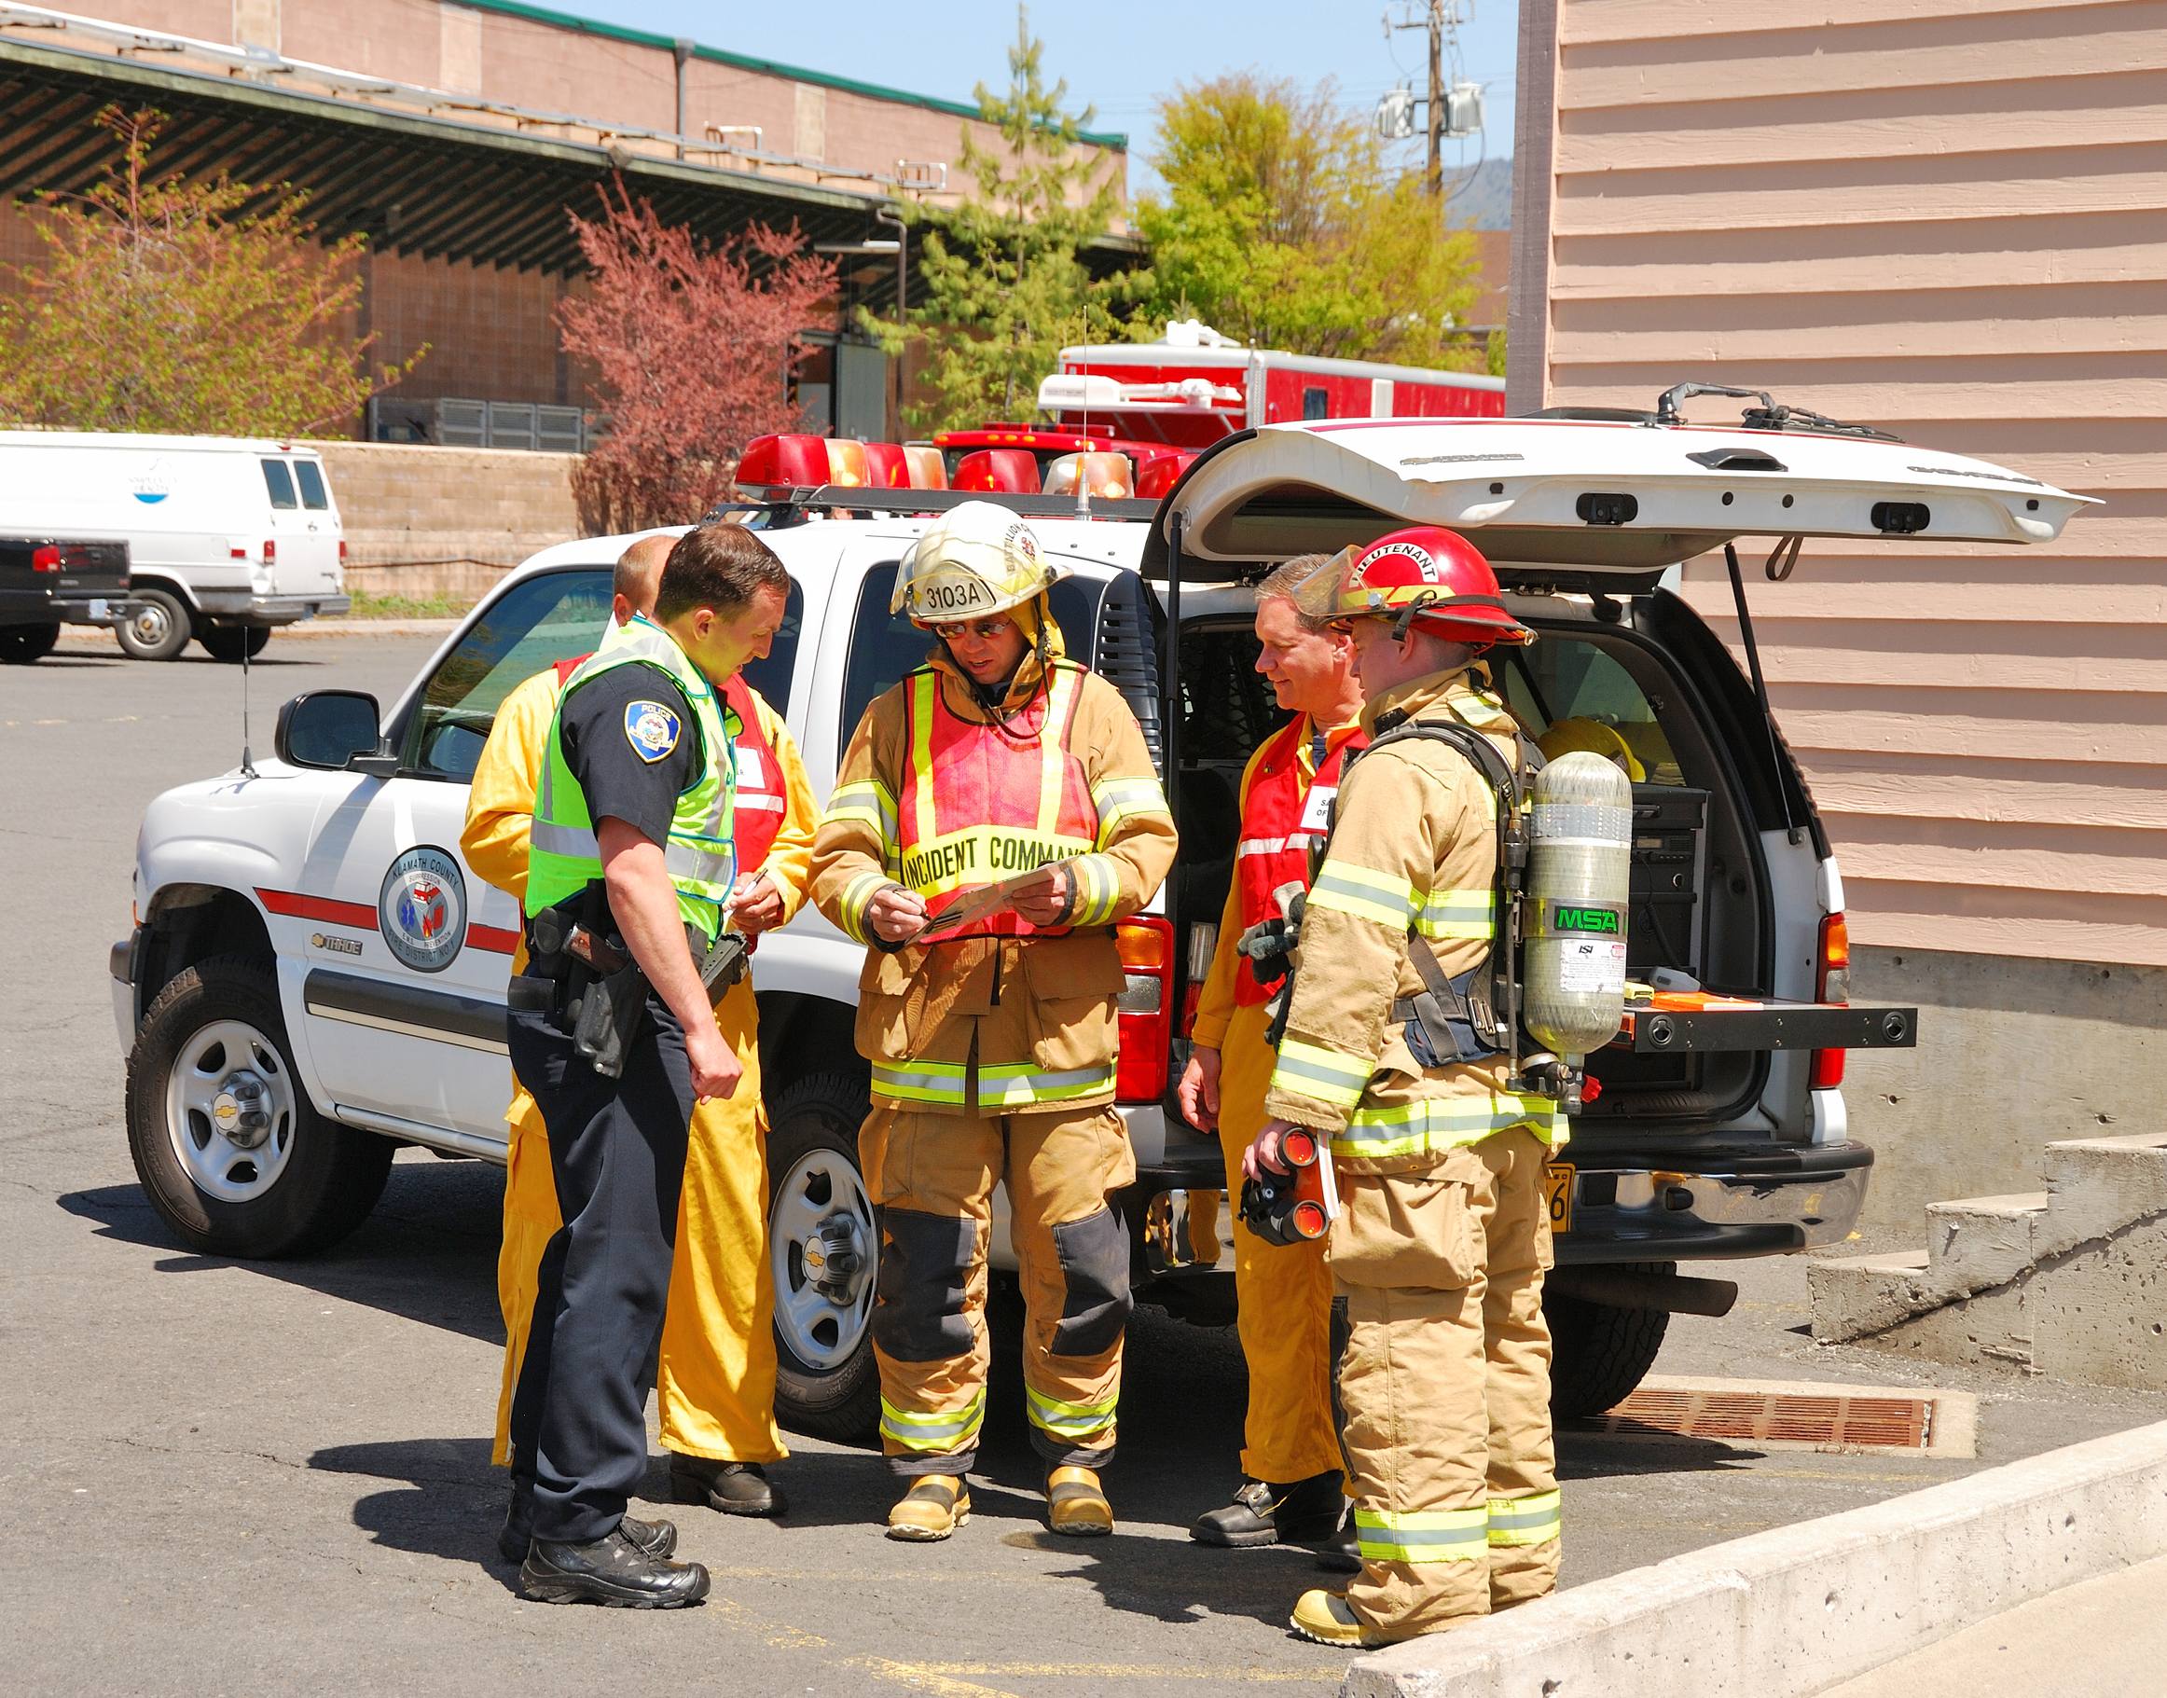
Emergency Response
Pre-planning
Pre-planning for potential incidents at liquid product terminals is extremely important
Fire departments that help provide protection to liquid product terminals should have:
Access to high-flow fire fighting foam equipment
Access to large supplies of compatible AR-AFFF foam available
Notes:
Pre-planning for potential events at liquid product terminals is extremely important. Fire department personnel should develop good working relationships with the terminal operators and be very familiar with their operations. A significant piece of this pre-planning must include consideration for mutual aid partners. Fire departments that help provide protection to liquid product terminals should have access to high-flow firefighting foam equipment and access to large supplies of compatible Alcohol-Resistant Aqueous Film-Forming Foam (AR-AFFF). In some areas this has been done by establishing caches of AR-AFFF and equipment through consortiums organized between multiple terminal operations and the fire department.
Fire department personnel should also be aware they may not be able to contend with a terminal fire operation and may need to contact outside resources for ultimate control of an emergency. Fire departments are encouraged to establish healthy working relations with these groups and with the storage facilities in their response area prior to an emergency arising.

Slide 12
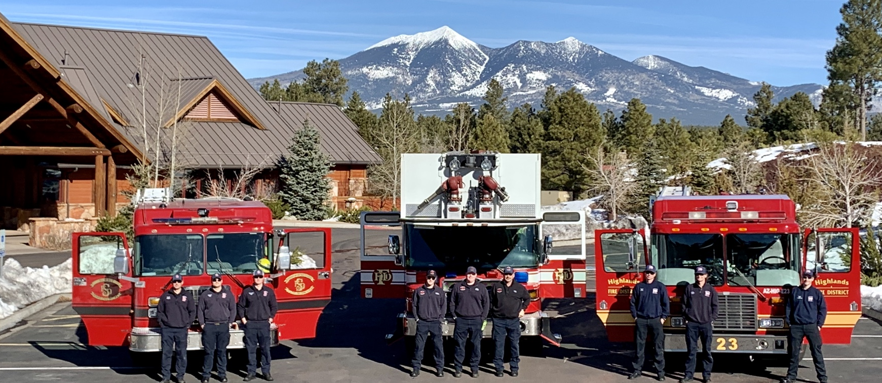
Emergency Response Planning
Consortiums between multiple tank farm operations & fire department
Fixed fire suppression systems currently best protection for large storage tanks
Fire department personnel should be familiar with systems & pre-calculate required flow rates
Pre-plan operations supplying systems
Practice exercise at least annually
Notes:
Group Discussion:
Ask participants who “these groups” are.
Answers will vary but could include mutual aid with industrial facilities or nearby jurisdictions.
Fixed fire systems are currently the best protection for bulk storage tanks. Fire department personnel should be extremely familiar with these systems and pre-calculate their required flow rates. They should also pre-plan operations supplying these systems. Practice exercises should be scheduled at least annually to make sure responders are familiar with the pre-established plans.
In some areas this has been done by establishing caches of AR-AFFF and equipment through consortiums organized between multiple terminal operations and the fire department.
The consortium philosophy is a process of collaboration between bulk storage vendors, ethanol production facilities, foam concentrate manufacturers, local and state public safety and regulatory agencies to develop a significant cache of AR-AFFF foam concentrates at a or several pre-determined geographical location(s). These resources are properly managed and supervised and available as a regional asset for ethanol-blended fuel incidents. No one agency, department or organization bares the financial burden of buying, storing and managing such a costly resource. Lastly, all organizations should consider and apply for grant funding where and when available.

Slide 13
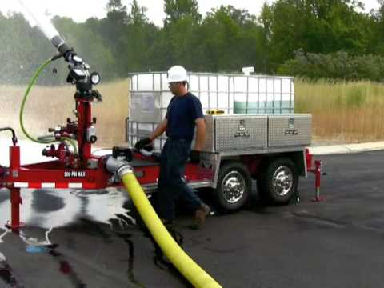
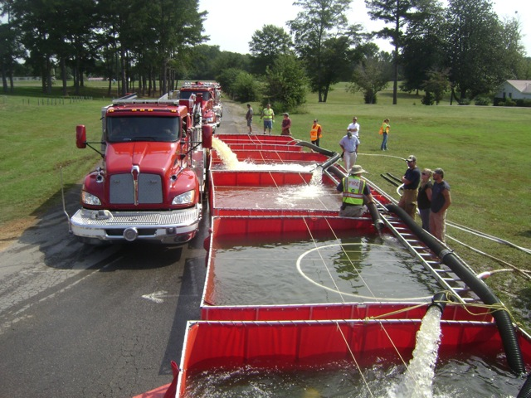
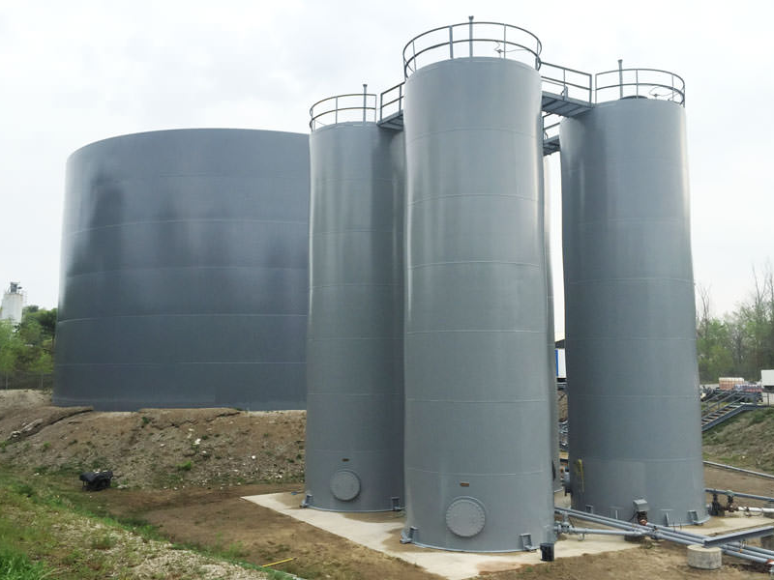
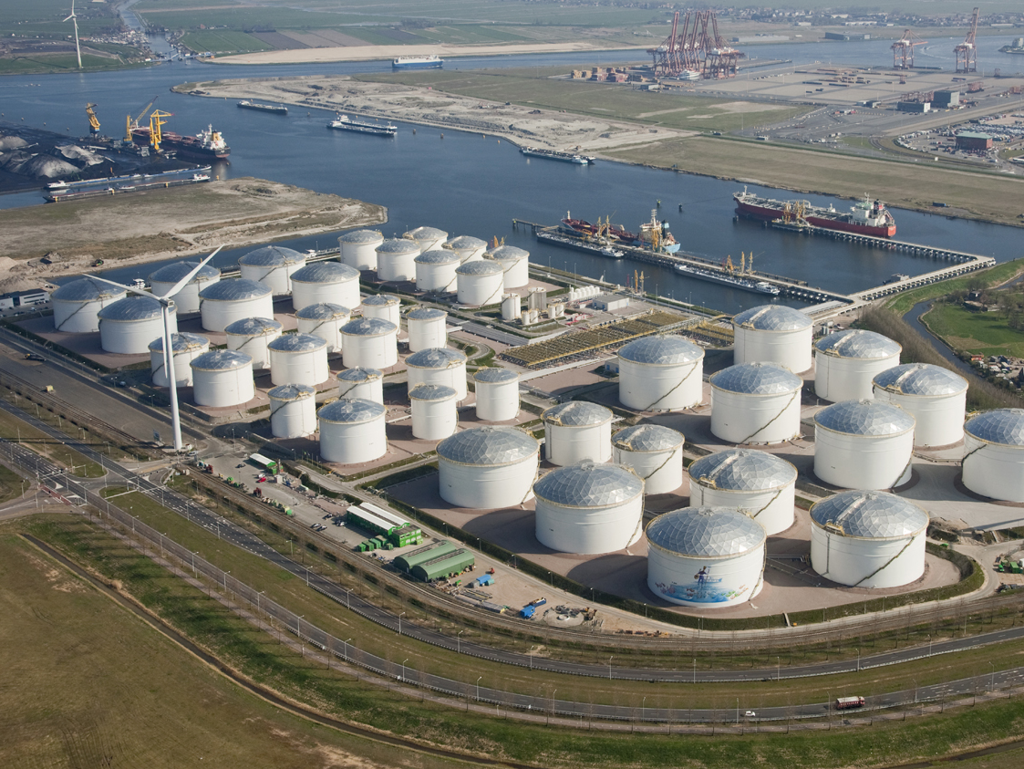
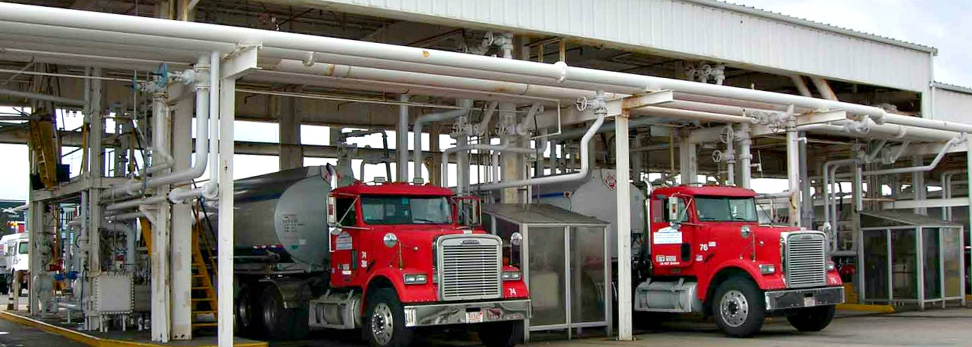
Key Considerations
Emergency response challenges:
Limited access for fire fighting equipment
Inadequate water supplies in area
Containment dikes & their systems
Miles of exposed product piping
Loading rack facilities
Notes:
Keep in mind that there are many different challenges involved in firefighting operations at a liquid product terminal. There may be limited access in both the terminal itself and in tank design for firefighting equipment. At times some locations may have inadequate water supplies to fight any type of significant fire. Personnel may have to contend with containment dikes and their systems, along with miles of exposed product piping. Liquid product terminals may also have loading racks subject to fire emergencies.
Liquid product terminal operations can be very complicated and responding to a fire emergency can be very dangerous to personnel. It is also not unusual for terminals that were originally built in remote areas to now be surrounded by commercial and residential growth.

Slide 14
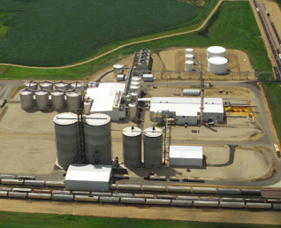
Working Relationships
Pre-established working relations between fire department & facility operators
Cooperative pre-planning is extremely important
Notes:
Again, pre-planning is extremely important, and pre-established working relations between the fire department and the facility operators cannot be over-emphasized.

Slide 15
Terminal Size Considerations
Smaller bulk distribution storage facilities may pose unique challenges to local fire departments
Possibilities include:
No fire protection
Unstaffed
Limited site resources
Flammable liquid fuels stored at facilities in modest quantities
Notes:
Smaller bulk distribution storage facilities may pose unique challenges to local fire departments. These facilities are located throughout communities to better distribute fuel to end-users. Storage tanks in these facilities can be of a multitude of styles and layouts, depending on age and location. Storage tanks may be vertical, horizontal, or a combination of both. Normally the flammable liquid fuels, including gasoline and the ethanol-blended fuels, are stored at these facilities in modest quantities. Most of these facilities do not have built-in fire protection systems. These facilities are normally designed with limited fuel spillage containment structures or areas and are typically unstaffed.

Slide 16
Terminal Size Considerations
Large distribution storage facilities also pose unique challenges to local fire departments
Possibilities include:
Size of fire emergency
Multi-dimensional emergency situation
Multiple type and large quantities of resources needed
Flammable liquid fuels stored at facilities in significant quantities
Notes:
Large bulk distribution storage facilities also pose unique challenges to local fire departments. Storage tanks in these facilities have high capacity and high throughput. A variety of different storage tanks may be present: vertical, horizontal, above ground or below ground or a combination of all of these. Flammable liquids including gasoline and the ethanol-blended fuels are stored at these facilities in significant quantities. These facilities have detailed emergency response plans due to the shear volumes stored on site.
Pre-established working relations between the fire department and the facility operators is extremely important. Pre-planning cannot be over-emphasized.

Slide 17
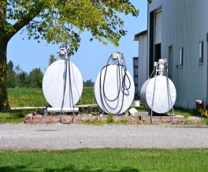
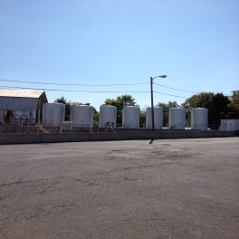
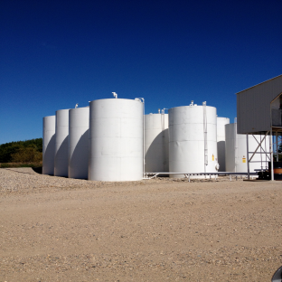
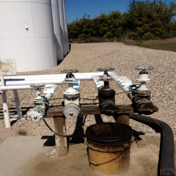
Group Discussion
17
Notes:
Group Discussion:
Ask participants if they are aware of any of these types of facilities in their jurisdictions.
Answers will vary.
Follow up by asking participants if they have planned their response to potential events at these facilities.

Slide 18
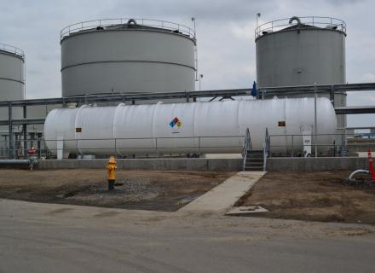
Storage at a Production Facility
Ethanol storage at production facility:
Ethanol tanks (1 & 2)
Denaturant tank (3)
Tanks are identified by markings
1
2
3
Notes:
Both denatured and undenatured/ neat ethanol can be stored at a production facility. The most common is denatured fuel ethanol (E95, E98). Ethanol blended fuels found at retail fuel stations are not generally found at a production facility.
There will be denaturant stored at a production facility such as natural gasoline or unleaded gasoline. Denaturants are added to ethanol through inline blending systems prior to the final product storage tanks.
A typical example is shown in this photo. In this tank configuration ethanol would be stored in the tanks identified as 1 & 2. The denaturant would be stored in the tank identified as 3.

Slide 19
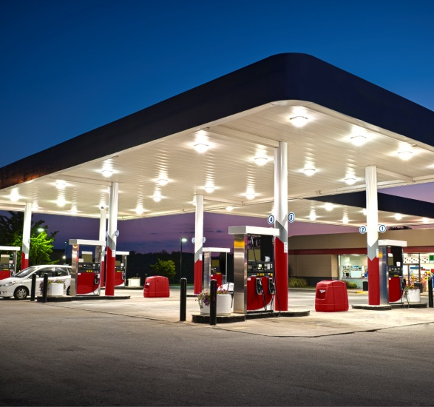
Retail Dispensing Stations
~121,000 retail fueling stations
Retail fuel storage configurations:
Most common underground tanks
Small volume above-ground steel tanks
Tanks are vertical or horizontal design
Filled by highway cargo tank trucks
Notes:
There are currently 121,000 retail fueling stations throughout the U.S. Depending on the geography, throughput volume, fire code and many other variables impact whether an above-ground or below-ground storage tank is used. Above ground storage tanks can be either vertical or horizontal in design; nearly all underground storage tanks are horizontal. Inventory is brought to the retail station by cargo tank trucks. Storage tanks configuration at retail include both above ground and below ground.
Some jurisdictions have hundreds if not more retail fueling stations of ethanol-blended fuels. Pre-planning each retail facility would be extremely time consuming and labor intensive. Since these facilities must be constructed and maintained to nationally recognized standards, development of a standard operating procedure (SOP) or standard operating guideline (SOG) may be more practical to ensure consistent operational practices to increase emergency responders and community safety if an ethanol-blended fuels incident were to occur.

Slide 20
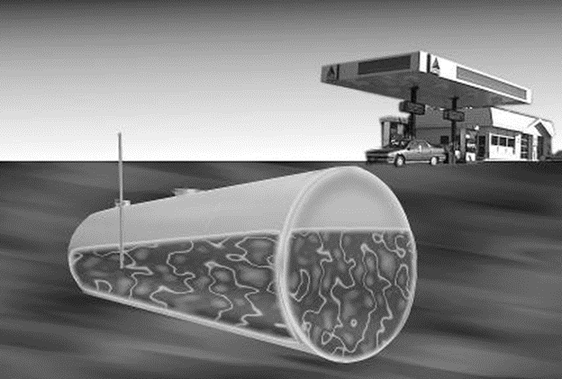
Retail Tank Configuration
Most common tank configuration is a horizontal underground tanks
Emergency shut-off valves
Loading & unloading points
Risers for multiple tanks color-coded/ marked to identify product
Notes:
At retail sites, the most common tank configuration is horizontal underground tanks. The maximum pressure under which any underground tank is capable of holding its contents is 0.5 pounds per square inch gauge (psig). Tank capacities range from a few thousand gallons up to 20,000 gallons. These tanks are typically constructed of steel or double walled fiberglass. Emergency shut-off valves will vary for each container due to design and construction differences. Loading and unloading points will vary due to design and construction. Risers for multiple tanks will be color-coded or marked to identify the product.

Slide 21
Summary
Denatured fuel ethanol is commonly found at liquid product terminals
Pre-planning for potential events at liquid product terminals is extremely important
Facility familiarization & relationships
Liquid product terminals vary greatly in capacity & the types of products stored
Retail fueling stations have many different storage tank configurations
Notes:
Denatured fuel ethanol (E95, E98) is most commonly stored in storage tanks made of carbon steel. Denatured fuel ethanol can also be stored in stainless steel storage tanks, these tanks are less common.
Pre-planning for potential events at liquid product terminals is extremely important. Fire department personnel should develop good working relationships with the terminal operators and should be very familiar with their operations.
Liquid product terminals will likely be equipped with fixed fire suppression systems, it is important to remember these systems could be rendered inoperable at the onset of an incident. From the liquid product terminals the ethanol-blended fuel arrives at local retail fueling stations. These stations will use underground storage and above-ground storage tanks. Although the amount of fuel stored at each retail fueling station is small, especially when compared to liquid product terminals, the sheer number of retail fueling stations requires that each possible emergency be pre-planned.

Slide 22
Activity 5.1: Ethanol in Your Jurisdiction
Purpose:
To allow participants to determine the potential for an ethanol emergency in their jurisdictions
Notes:
Time: 10-12 minutes
Materials: Worksheet 5.1
Instructor Directions:
Participants should work individually or in groups of two (if both are from the same jurisdiction).
Have participants read the items in Worksheet 5.1 and write down their answers.
After about five minutes call time and conduct a discussion covering each item.
As participants discuss the items, point out differences. Depending on the audience, it is likely that participants may have vastly different guesses for the number of retail stations in their jurisdictions.

