Slide 1
Chlorine Tank Car Valves and C-Kit

Slide 2
Tank Car Valves
ACF, Midland, Eagle angle valves
Equivalent angle valves
New Dual Valve Systems
  Midland and Descote
Others
  Pneumatically operated valves
Notes:
All angle valves are standard 1” valves, the ACF 1301 was the industry’s first model of angle valve. We will discuss the new dual valve system, or next generation pressure plate in later slides.

Slide 3
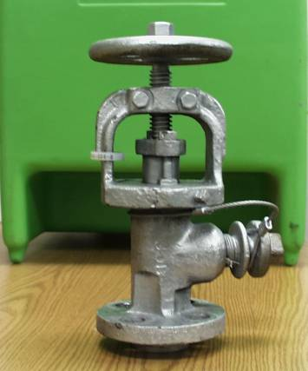
ACF Angle Valve
Hand wheel
Yoke
Packing retainer
Welded outlet
Body
Notes:
The ACF 1301 valve is a very basic design, it essentially has 6 main parts. The stem and hand wheel, yoke, packing follower, body, plug, and bottom seat.

Slide 4
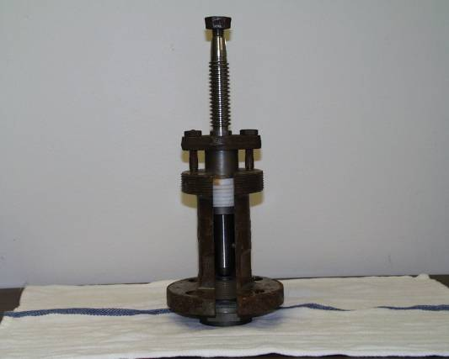
ACF Angle Valve (cont.)
Yoke & hand wheel missing
Stem
Packing
Body
Seat
Notes:
This slide shows a cut-away section of the ACF valve, important to note the Teflon packing rings that prevent chlorine from migrating out of valve. The two packing nuts allow adjustment of the packing follower that sits above the Teflon packing. There is also a gasket that is installed between the bottom seat and valve body.

Slide 5
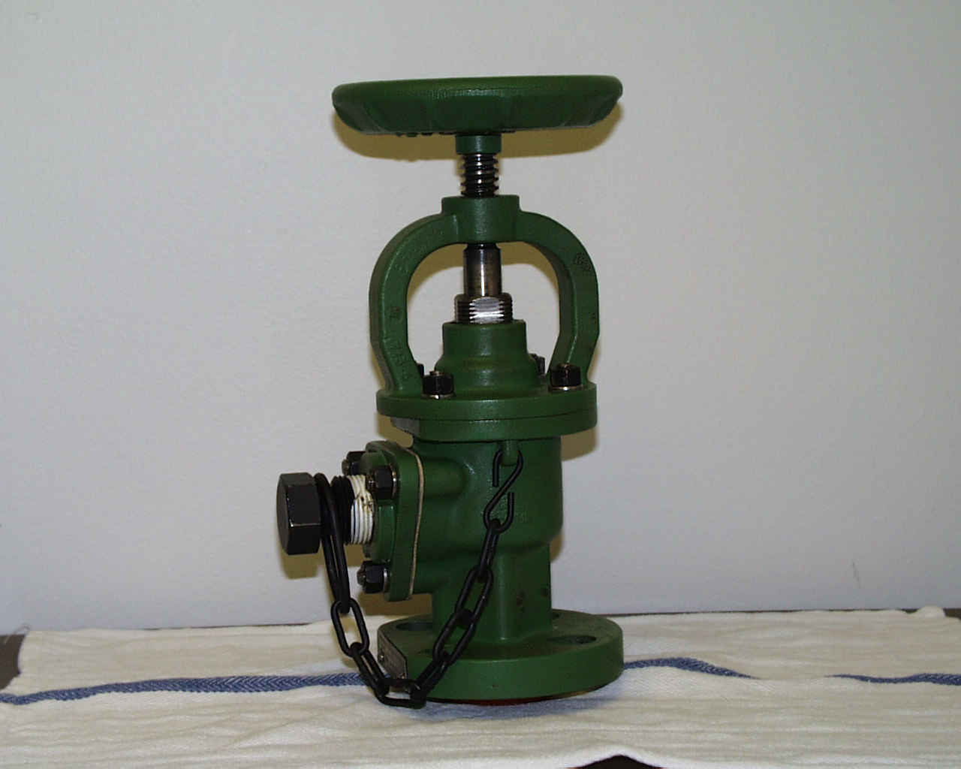
Midland Angle Valve
Hand operated only
Outlet is bolted to valve
Notes:
The Midland angle valve has many different features from the ACF 1301 valve. Most notable is the operation which is “hand tighten only” as opposed the ACF, which is closed with a wrench. Another difference is the outlet port on the Midland valve can be replaced if worn out or damaged.

Slide 6
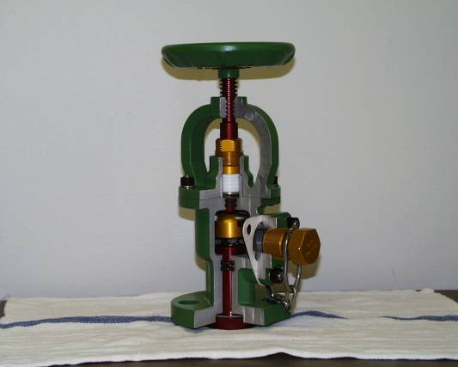
Midland Angle Valve (cont.)
Hand wheel
Packing
Yoke
Seat
Plug
Body Insert
Notes:
The Midland valve has a soft seat, as opposed to metal on metal. The hand wheel is designed to break if too much torque is applied while closing valve. The Midland valve has 3 redundant seals, through multiple “O” rings and Teflon packing, in which to stop chlorine from leaving the valve. It has a single packing adjustment nut. The seat is recessed in a cup that finds its sealing surface to lower seat. The bottom seat is a pressure fit, which means that there are no threaded areas, and that the valve MUST be in the open position when applying to car. Failure to do so will damage the seat and cause the valve to malfunction.

Slide 7
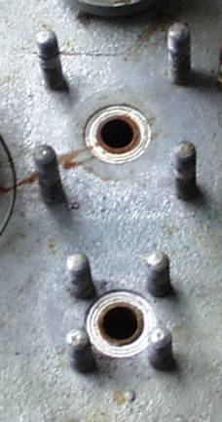
Gaskets in Manway
Tongue and groove gasket
Valve can be installed on shoulder
Shoulder must not have defects
Notes:
The valves are installed onto the pressure plate of the car by inserting a gasket into the grove. There are 4 angle valves and 1 pressure relief device in this application. It’s important to ensure the sealing surface is clean and that the valve fits snugly into the grove. If there is damage to the inner or outer edges, the valve seat can hang up and not allow a true seal.

Slide 8
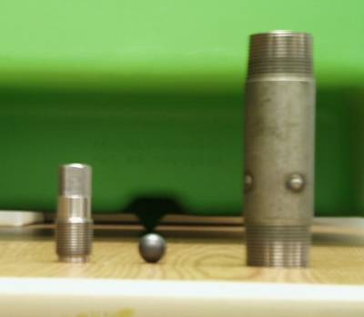
Excess Flow Valve
Liquid Lines Only
7,000 lbs/hr
11,000 lbs/hr
15,000 lbs/hr
37,000 lbs/hr
Dual Valve Systems covered later
Different Styles
  Midland
  Pneumatically operated valves (POV’s)
Notes:
The excess flow or check valve prevents the flow of chlorine from the car if there is a line break or liquid valve failure. The most common excess flow valve is the 15,000lb per hour check.

Slide 9
Pressure Relief Device
Pressure Relief Device (PRD’S)
  Breaking pin and rupture disc assemblies
  Spring loaded relief
    Set to 375 PSIG
    Some have tell-tale valves
    Two main manufactures, Midland and Crosby
    Same basic design
    C-Kit must be applicable to all designs
Notes:
Pressure relief designs, Midland has rupture disc, Crosby has break pin. If equipped with tattle tale or tell tale valve, must be checked that it is closed prior to shipment.

Slide 10
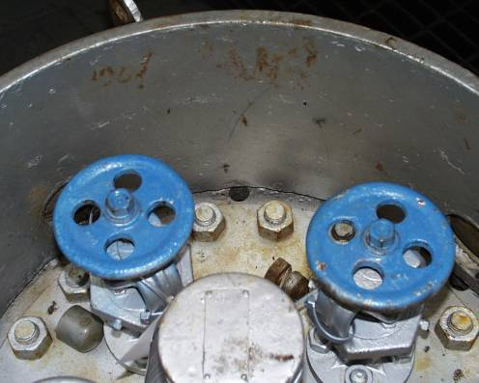
Potential Leak Points
Manway to tank nozzle
  Installed by impact wrench
  Hand wrench
  In C-Kit
Notes:
Unfortunately this can be the worst type of leak. The only way to stop this is to tighten all 20 bolts down in a crisscross pattern, you may require a mechanical advantage such as torque multiplier.

Slide 11
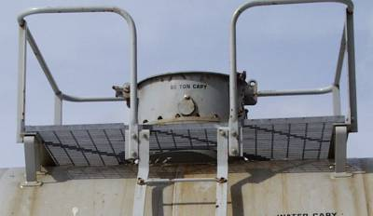
Potential Leak Points (cont.)
Manway to tank nozzle
  Call the shipper
  Remember the drain hole in manway plate
  May require torque multiplier
Notes:
If leak cannot be stopped, you must contain vapors and arrange to transload car.

Slide 12
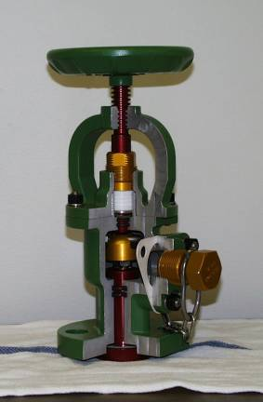
Potential Leak Points (cont.)
Packing
  Close valve
  Tighten packing nut
Notes:
If leak is from packing gland, make sure valve is closed and tighten packing gland.

Slide 13
Potential Leak Points (cont.)
Leak at valve seating surface
  Open and close
  Install plug
Notes:
If leak is from throat or outlet port, tighten plug in valve. If this is a vapor valve, you can open and reclose valve to see if you can stop the leak. DO NOT ATTEMPT THIS PROCESS ON A LIQUID VALVE IF CAR IS LOADED.

Slide 14
Potential Leak Points (cont.)
Leak at valve outlet
  Close valve
  Tighten outlet assembly bolts
  Replace outlet flange gasket or assembly
Notes:
Leak around outlet port, close valve, tighten outlet flange bolts, and replace outlet flange gasket or assembly.

Slide 15
Potential Leak Points (cont.)
Leak valve to manway
  Gasket to manway
    Tighten nuts
  Seat insert gasket
    Close valve
Notes:
If a leak occurs at valve connection to pressure plate you can try tightening the 4 bolts. On the Midland valve, you will also have to ensure valve is tightly closed, as this valve has a floating seat.

Slide 16
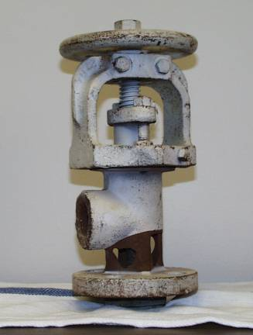
ACF Angle Valve
Actual valve with corrosion to body due to moisture in product unloading line
  Apply C-Kit
Notes:
Valve with extensive damage to body

Slide 17
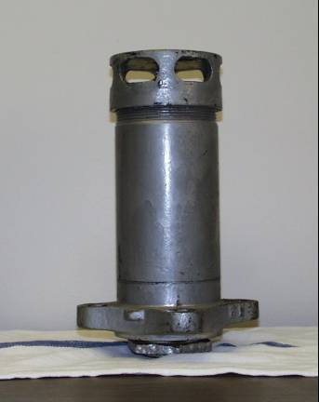
Potential Leak Points (cont.)
Through the valve
  Check lead disc
  Why is it leaking
Install C-Kit
Note: Make sure car is not liquid full or over pressurized
Never cap pressure relief valve (PRV) without providing secondary relief or 24/7 monitoring
Notes:
If possible, always check pressure in car to assess why PRV is leaking or releasing. Be sure to confirm why valve may failing prior to installing capping kit. Reasons for excessive pressures are liquid full, damage due to impact, excessive heat impingement, and possible internal contamination.

Slide 18
Potential Leak Points (cont.)
Pressure relief valve to manway
  Tighten nuts
  Check top lead disc
Install C-Kit
Notes:
When leak at valve to pressure plate is confirmed, tighten all 4 bolts.

Slide 19
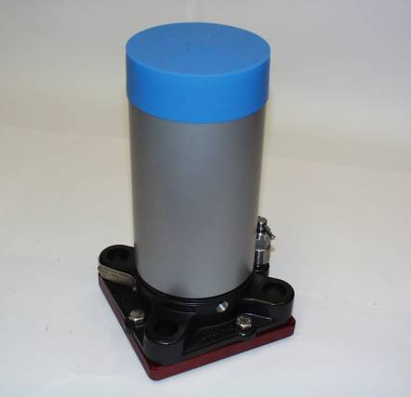
Midland Pressure Relief Valve
Dust cap
Flue
Inspection valve
(Tell-tale)
Notes:
Here is a example of a tattle tale valve on the side of the base of the Midland PRV

Slide 20
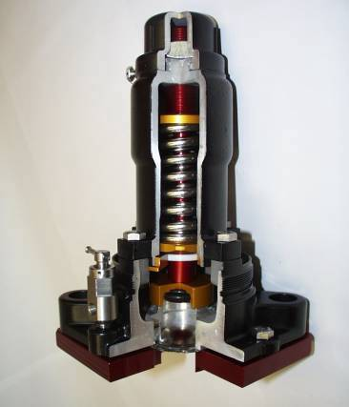
Midland Pressure Relief Valve
Inspection valve
Vapors exit here
Rupture disc
Notes:
Cutaway view of Midland PRV

Slide 21
Before Applying the Emergency Kit “C”
Use of a C-Kit is a last resort
Always try to stop leak without applying kit first
Once kit is applied, car will no longer be able to move without a one-time movement approval (OTMA) from the DOT

Slide 22
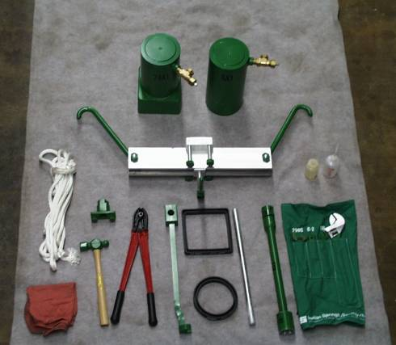
Chlorine Institute Emergency Kit “C”
Notes:
Here is a picture of what is contained in a C-Kit
C-Kit is designed for angle valve and pressure relief valve
NOT designed for liquid full cars
Always store hoods with valves open
Keep clean and do NOT use lube on threads
Periodic inventory checks and inspections are recommended

Slide 23
Additional Tools and Items Needed
Rags
Ammonia – for detection of leak
  Bottle
  Sealed container
Pipe wrench
Multiplier– to assist in tightening pressure plate
Monel pressure gauge to 500 psi
1” Stabber pipe (2)
1” Flush plugs
Notes:
Customize your kit as required, as you will only get the basic equipment when you receive your C Kit

Slide 24
Additional Tools and Items Needed
Allen wrench to fit 1” plug
Teflon® tape
Duct tape – hold open port holes on protective housing
Pipe wrench
36” Cheater bar – to assist in tightening pressure plate leak
3” Plastic pipe – for isolating valves to help identify leak source
Notes:
Additional tools, it may be necessary to split your kits into 2 boxes for easier handling

Slide 25
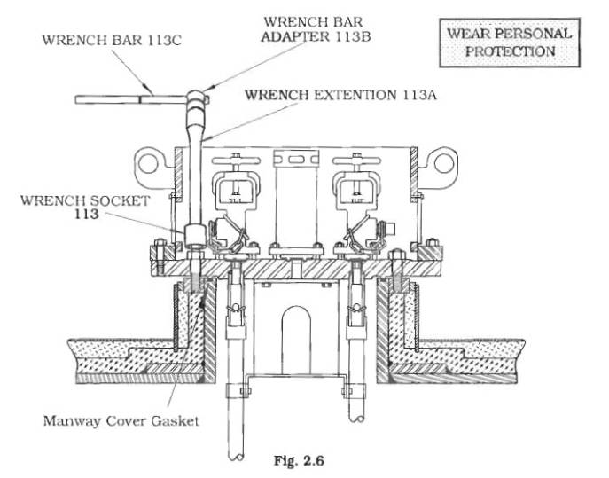
Leaks on the Pressure Plate Flange
Pressure plate flange
Notes:
Using wrench bar 113C, adapter 113B, wrench extension 113A and wrench socket 113 to tighten pressure plate to tank nozzle.
Using a multiplier to assist in this may help, along with a cheater bar extension on the wrench bar.
This flange is tighten at tank qualification to 500 – 700 ft pds.
There is no hood to stop this leak, if leak continues you will need to depressurize car and clean.

Slide 26
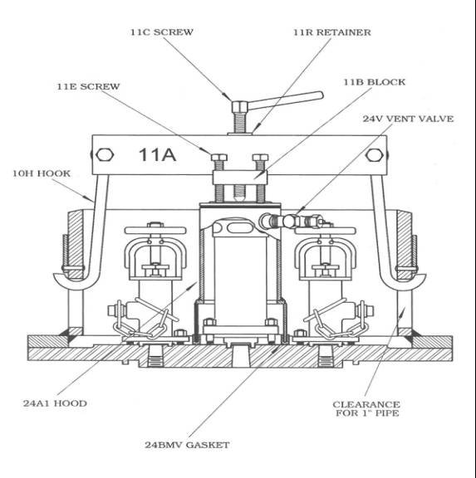
Leaks Around the Safety Relief Valve
Notes:
Using 24A1 hood to stop leak on PRD
Insure 24V vent valve is open
Center 11B block on hood using gasket 24BMV – keeping 10H hooks as straight as possiable
Use 11C screw to center and “snug” everything up and hold in place
Using a star pattern, tighten down hood using 11E screws
Close 24V vent valve and check for leaks

Slide 27
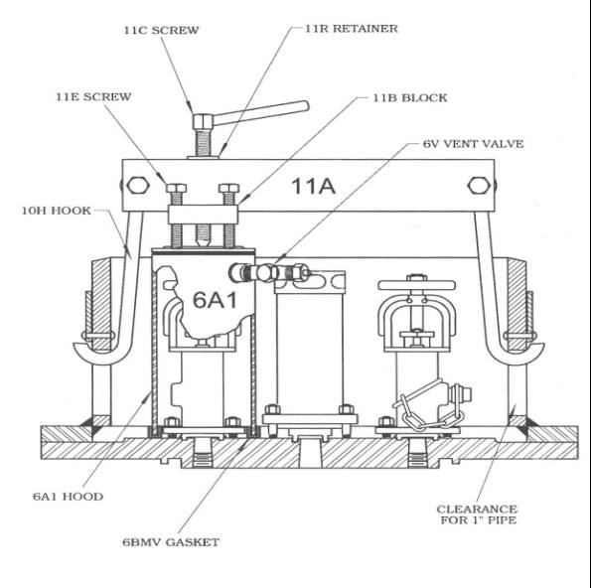
Leaks Around the Product/Use Valve
Notes:
Using 6A1 hood to stop leak on angle valve
Insure 6V vent valve is open
Center 11B block on hood, using gasket 6BMV – keeping 10H hooks as straight as possible
Use 11C screw to center and “snug” everything up and hold in place
Using a star pattern, tighten down hood using 11E screws
Close 6V vent valve and check for leaks

Slide 28
C-Kit Mounting to the NGRTC “Enhanced Fittings” Package
(Dual Valve System)
Notes:
Here are a few slides that cover off the kit installation with regards to the next generation tank car configuration.

Slide 29
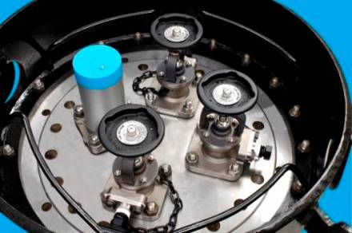
Capping NGRTC “Enhanced Fittings”
The NGRTC fittings package has new protective housing for chlorine applications
  Lower profile
  Wider layout, equal to an LPG style or 20” housing
Four bars are mounted inside the housing to accommodate the C-Kit
Notes:
Because of the wider profile of the protective housing, four bars were installed on the inside walls of the housing to accommodate the C and Midland Kits

Slide 30
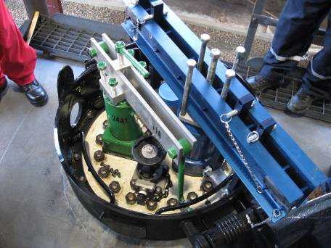
Mounting Options for
Emergency Kits
The angle valves require the same capping can as the PRV
  Midland capping can #4 is the correct can to use
  The C-Kit capping can 24A1 is the correct can to use
Note that two kits were able to be applied simultaneously using the bars inside the dome
  The Midland Emergency Response Kit (ERK) could also use the port openings to connect just as is currently done today
  If using the port openings, only one kit could be applied at a time
Notes:
An example of multiple kits being installed simultaneously.

Slide 31
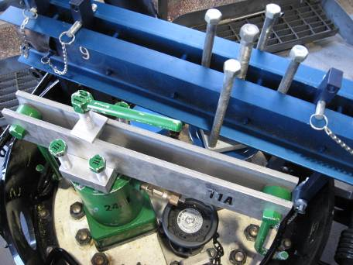
Mounting Options for
Emergency Kits (cont.)
The bars are being used for the first 25 railcars that were in the service trial. Other options could be considered
  Any new designs need to consider the “reach” of the C-Kit hooks
The C-Kit will work in the port holes through the following:
  Unbolt one of the hooks
  Mount both hooks into port holes
  Re-attach the hook and tighten normally
Notes:
The Chlorine Institute Emergency Preparedness Issue Team (CI EPIT) has made recommendations for future tank car designs to keep the responders and equipment in mind.

Slide 32
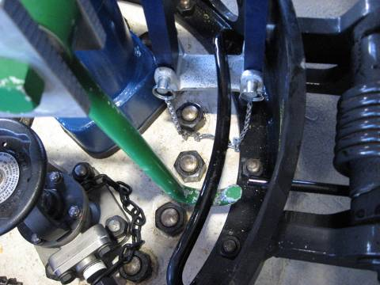
Mounting Options for
Emergency Kits (cont.)
With the four interior bars, the C-Kit hooks and the ERK tie bars have room to “find” the right spot to create a good connection for sealing over the capping can
The bar does not interfere with the valves or the side of the protective housing
Notes:
The interior bars provide a good anchor point for both kits

Slide 33
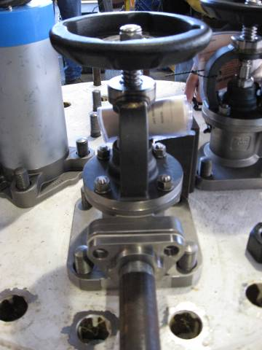
Mounting Options for
Emergency Kits (cont.)
The angle valve does not require hand wheel to be removed before capping with the Midland #4 can or the C-Kit 24A1 can
  Removal of hand wheel does make the application easier to accomplish
The flange face plate also needs to be removed before capping
  Recommended practice to aid in removal of the flange is to apply a 1” pipe (as shown) to help pull out the flange plate
  The 1” pipe is not included in either the ERK or C-Kits and would need to be added
Chain and plug do not need to be removed, wrap these around the valve to keep out of the way of the can
Notes:
Some of the options to consider when you are going to install the kits on the next gen cars.

Slide 34
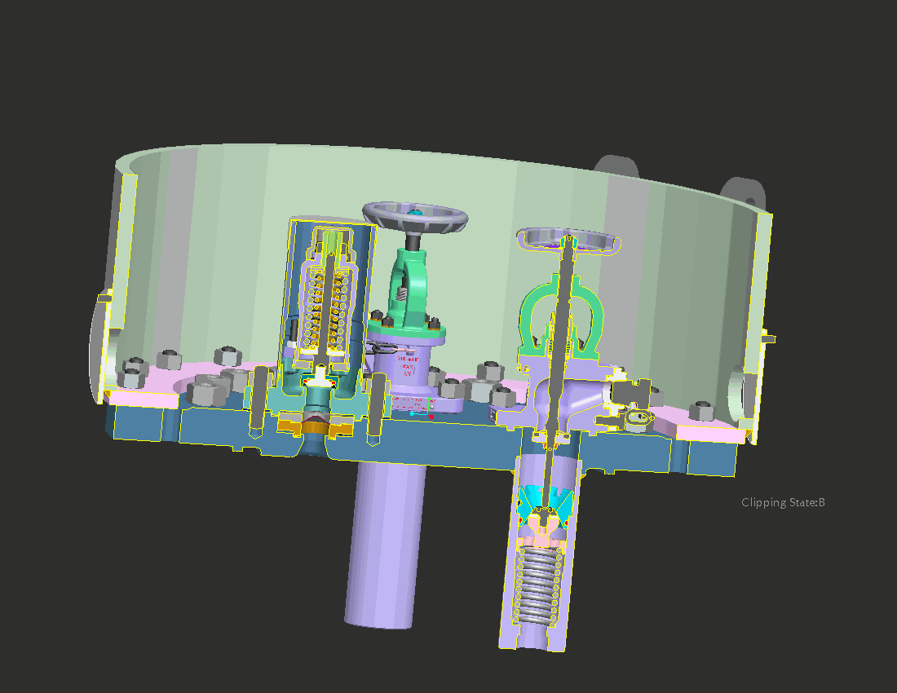
Side View of the NGRTC Assembly
The check valve is mechanically operated by the angle valve
  The check valve spring maintains positive seal on valve until pushed open by the angle valve stem
Primary seals are below the pressure plate surface
PRV rupture disc is mounted in the pressure plate
  Mounting is separate from PRV
Notes:
Internal check valves are mechanically operated, which means in the event of a rollover situation, in which the valves are damaged or sheared off, there will be no product loss.

Slide 35
NGRTC Valve Operation
The A-718 angle valve operates the same as a current angle valve
  Left turn (counterclockwise to open) and right turn (clockwise to close)
The stem is a descending stem so:
  The hand wheel will be at its highest point in the closed position
  The hand wheel will be at its lowest point in the open position
The stem interacts with the check valve to push it open
The check valve is the primary seal
Both the check valve and angle valve have soft seats allowing better sealing
Notes:
The operation of the valve has been engineered so that you will still operate the valve in a counter clock wise motion to open.

Slide 36
Movement Requirements
Once an emergency kit has been used to secure a leak, the shipper will be required to obtain a one-time movement approval (OTMA) from the U.S. Department of Transportation if the tank car is going to continue to be moved. This is referred to as a temporary certificate in Canada.
Notes:
This permit is known as a one time movement approval in the U.S and temporary certificate in Canada

Slide 37
Hands On C- Kit
Class will be divided into groups
Apply C-Kit and Midland kit to the NGRTC Dome
Each practice dome does have a leak point, rigged with air

Slide 38
Gasket Inspection and Replacement
Inspect Viton® gasket prior to use
Look for cuts, nicks, abrasions
Inspect gasket before storage for manufacturer defects
Gasket has a 4-year shelf life
Also inspect hood for damage to sealing surface or where the gasket is installed
Indian Springs is one known manufacturer

Slide 39
WHAT DID WE COVER?
Experience - lessons learned
Training - sharing
Adaptation

