Slide 1
CHLORINE TANK CAR AND RAIL SAFETY

Slide 2
Module Objectives
Review Chlorine Railcar
  Construction
  Markings & stencils
  Valve arrangements (overview)
Rail Safety
  General response considerations
  Communications
  Railroad HazMat
  Railroad hazards
  Incident command structure
  Hazard recognition
  Introduction to damage assessment

Slide 3
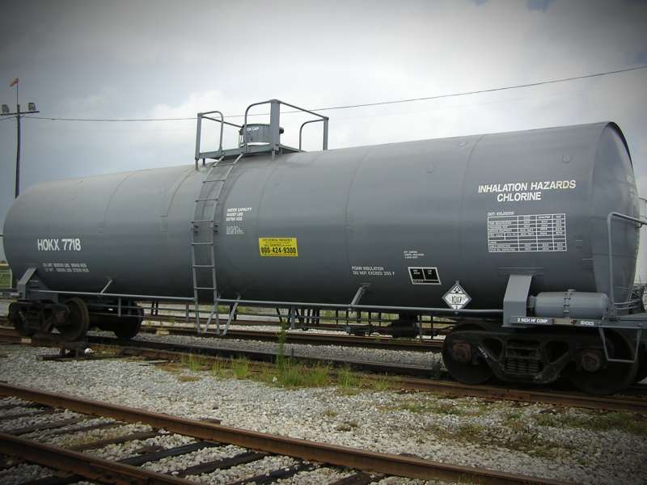
90 Ton Chlorine Tank Car
Notes:
The largest mode of chlorine transportation by rail or highway is the 90-ton rail tank car. Railcars are special purpose DOT Specification 105J500W or 105J600W cars (built according to the Interim Rule) that are jacketed and insulated.
The cars have no bottom outlets.
The cars are constructed of unlined carbon steel.
The typical lading is around 14,700 gallons or 180,000 pounds

Slide 4
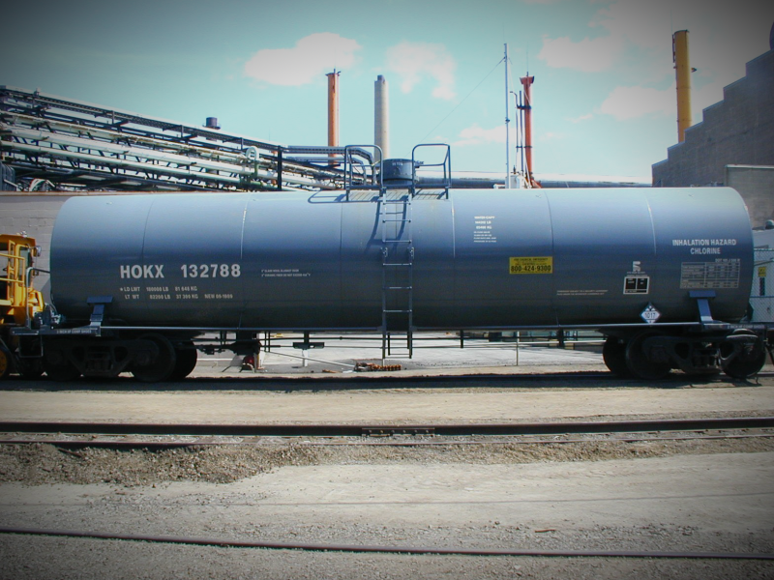
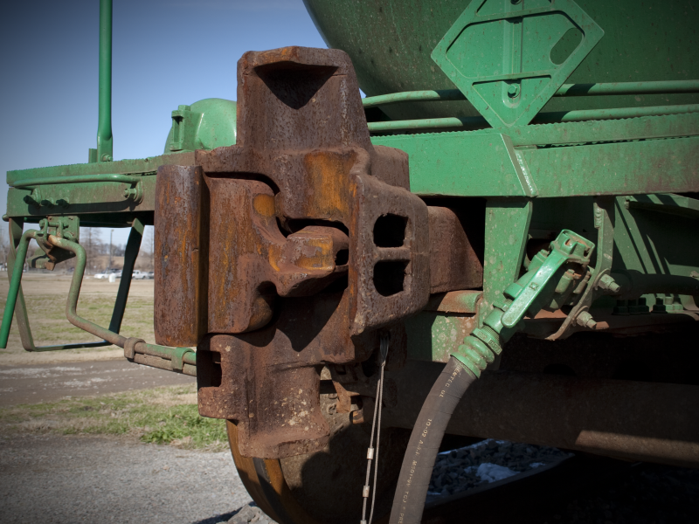
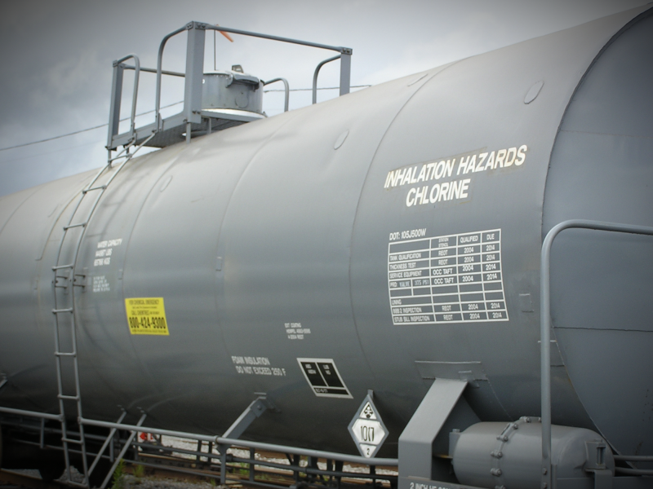
Chlorine Tank Car Construction
Identifying Features in an Emergency
Carbon Steel
  Rating of 500 or 600 PSIG
Insulated
Metal jacketed car
Top outlet only
Double shelf couplers
Notes:
If a derailment or accident obscures the placards and stencils, there are construction features you can recognize in an emergency. Chlorine tank cars are constructed specifically for chlorine, but may share some construction characteristics with other hazardous materials tank cars.
Tank cars are constructed of carbon steel and will have a pressure rating up to 500 or 600 psig. Chlorine tank cars are insulated, covered by a metal jacket. You can identify a jacketed car by the type of welds on the car – lap welds, not super-strong hand welds – and the covering over the body bolsters. You may see the car’s jacket ripped away in an accident, exposing the insulation and tank underneath. One of most recognizable features is that they have top outlets only – no underside valves or pipes. The cars also have double shelf couplers which are used to help prevent the cars from becoming uncoupled in a derailment – an uncoupled car can become a piercing threat to neighboring cars.

Slide 5
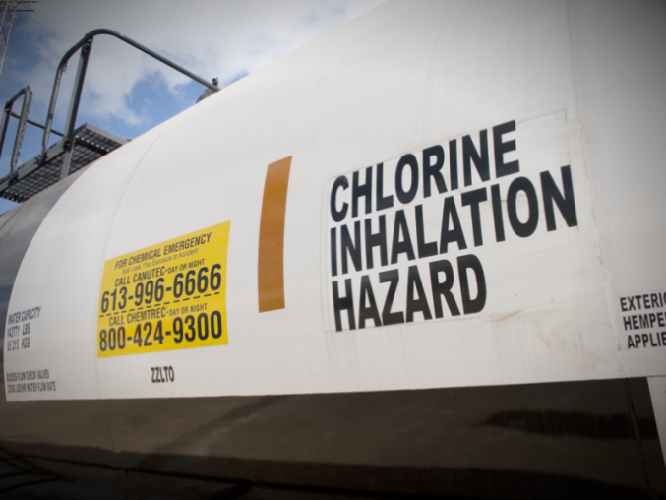
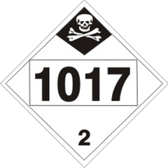
Stencils & Markings
Notes:
Chlorine tank cars are recognizable by two major components – placards and stencils. The 1017 chlorine placard will be placed on both sides of the car, as well as each end. Since chlorine is a class 2 poison inhalation hazard, chlorine tank cars will be stenciled “chlorine” and “inhalation hazard” on each side. By law, hazardous materials transport containers must provide an emergency contact number – look for this phone number displayed on the tank car. In these examples, the shipper has registered with CHEMTREC as their emergency contact.

Slide 6
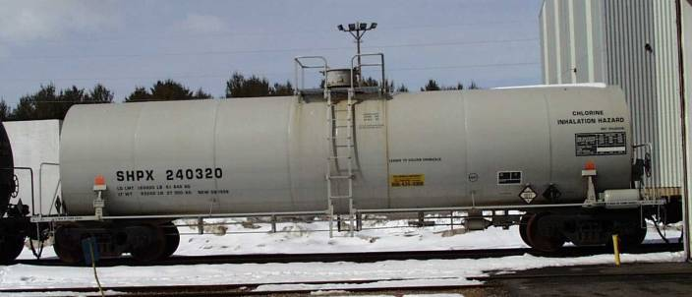
Stencils & Markings (cont.)
Car Number & Capacity
Marking & Test Dates

Slide 7
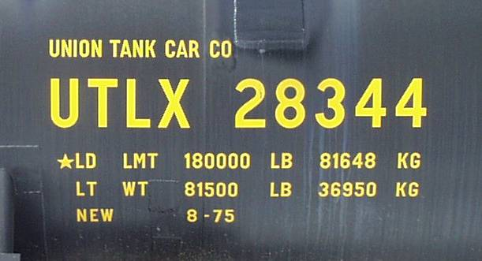
Chlorine Tank Car Number and Load Limit
Gross Limit 263,000 lb
(cars built to 286 K grl std will be higher gross limit)
* = Net Limit Do Not Exceed

Slide 8
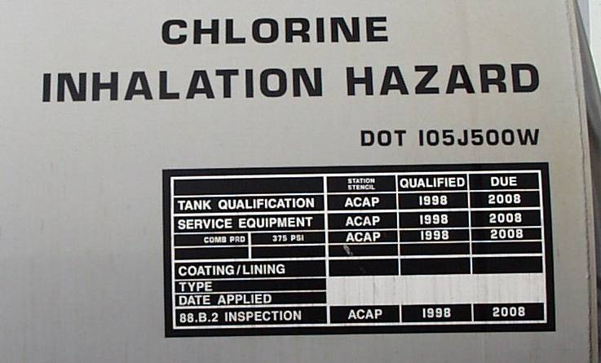
Markings and Test Dates
DOT CLASS
TEST DATES
PRD INSTALLATION

Slide 9
Markings
Shall be legible
Shall be of the proper size
Shall be in the proper location
Shall contain all required information
Shall display inspection and test dates
Shall display proper shipping name

Slide 10

Chlorine Tank Car
Protective housing
A END
B END
Hand brake control
LEFT SIDE
No bottom outlets
Insulated jacket

Slide 11
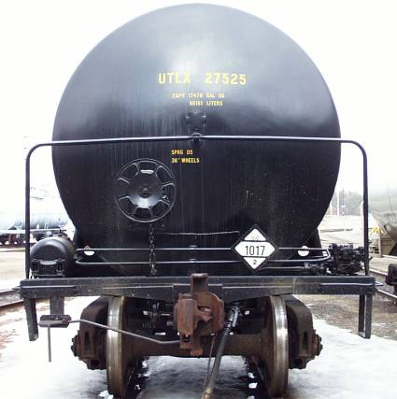
“B” End Tank Car
LEFT SIDE
RIGHT SIDE

Slide 12
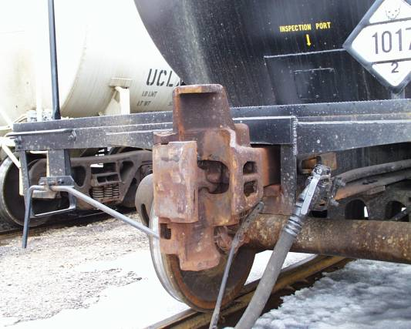
Double Shelf Coupler

Slide 13
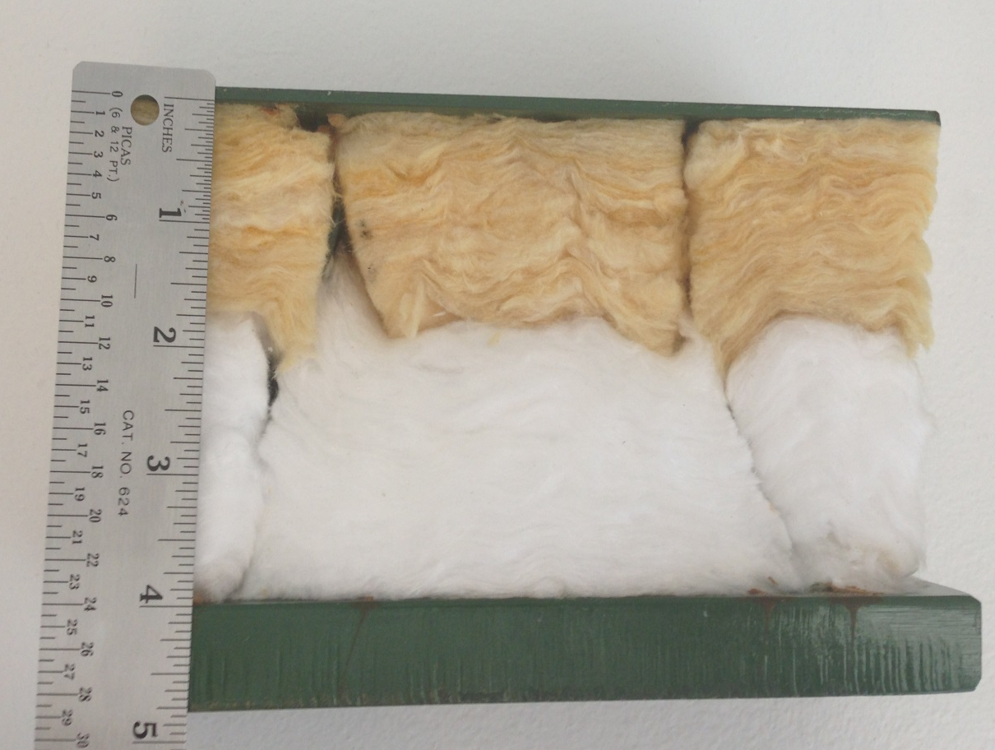
Tank, Thermal Protection System, Jacket
Actual Cutaway
Jacket
Insulation
Thermal protection
Tank thickness

Slide 14
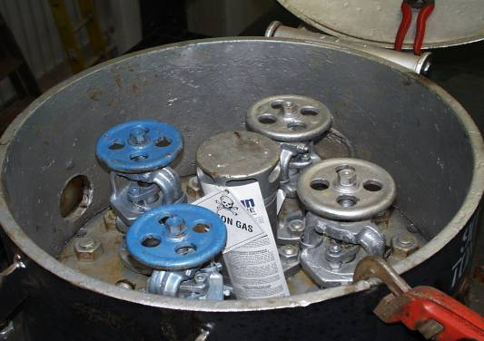
Valve Arrangement - Typical
Tank Car and Tank Truck
Safety
valve
Liquid
valve
Vapor
valve
Vapor
valve
Liquid
valve
Notes:
This is currently the most common chlorine valve arrangement found on cars built prior to 2012. The valve arrangement inside the manway cover of both tank cars and tank trucks are identical. There are two liquid valves, which are attached to dip tubes that run down inside the tank to the bottom of the tank, and two vapor valves, which provide access to the vapor space above the liquid. The liquid valves will always be oriented lengthwise with the tank – this is to allow the dip tubes to be submerged in as much liquid as possible. For this valve arrangement, liquid valves also have excess flow check valves located below them. They typically allow flow of around 15,000 pounds of product per hour per valve. The vapor valves will always run perpendicular to the length of the tank. The component in the center of the valves is the car’s pressure relief device. This is necessary to relieve elevated pressure from inside the tank. The pressure relief device is set to relieve at 375 psig. Chlorine cars are typically shipped with a seal placed on the car’s closed protective housing lid. If the seal has to be removed, write down the number of the seal. Full cars are typically at around 80-150 psig pressure. Residue cars can have pad pressures exceeding 180 psig.

Slide 15
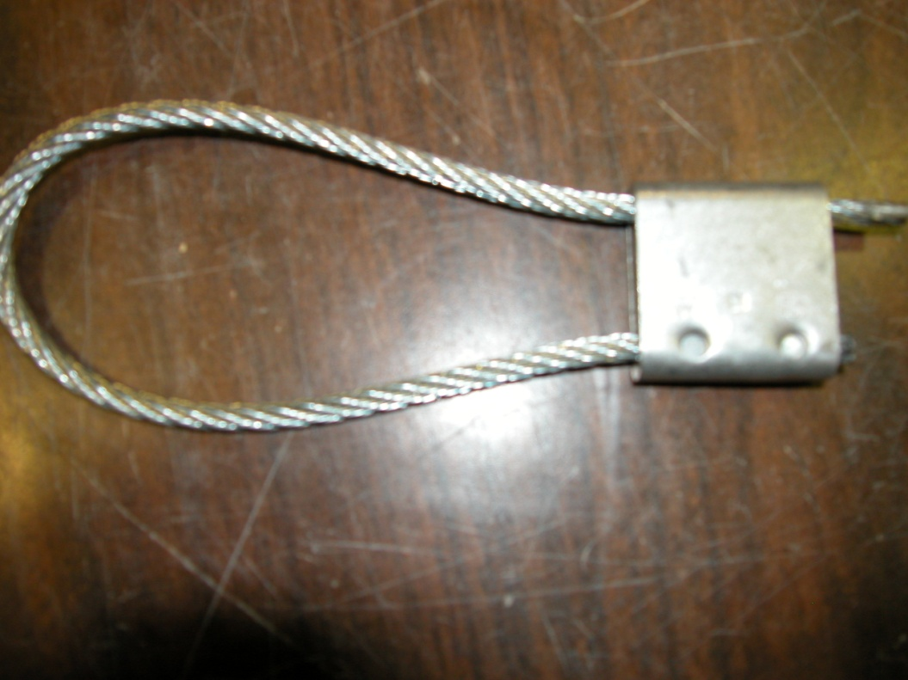
Typical Car Seal

Slide 16
Excess Flow and Eduction Pipes
x
Liquid valve
Liquid valve
Manway Plate
x
Excess flow
Eduction legs

Slide 17
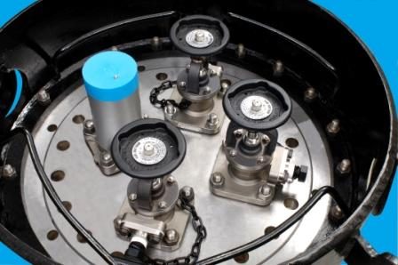
Valve Arrangement: Dual Valve System
Safety
valve
Vapor
valve
Liquid
valves
Notes:
Positive seal under all fittings (true check valve)
Design requires valve pairing between top valve and check valve
Design to fit in 18- and 20-inch manway cover plates
CI recommendations include option of 3 valves or 4 valves on manway

Slide 18
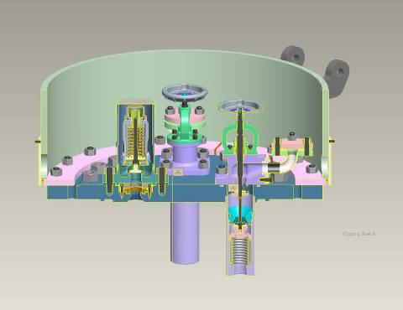
Valve Arrangement – Dual Valve System
Liquid valve
outlet
Vapor valve
outlet
Relief valve
Spring loaded check valve

Slide 19
Unloading Chlorine Tank Cars
Notes:
Tank cars are normally pressured off with very dry air through the vapor valve assembly (at least -40 degree dew point air) or nitrogen
The liquid unload valves have internal dip legs that get within ~2 inches of the bottom of the car

Slide 20
Summary of Key Points
DOT specification 105J500W or 105J600W
Top outlet only
Compressed liquefied gas
One-inch liquid and vapor valves
Safety relief valve (SRV) releases at 375 psig

Slide 21
Rail Safety

Slide 22
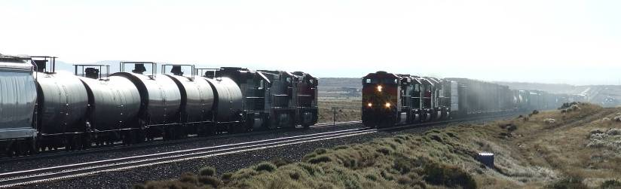
Transporting Hazardous Materials by Rail
Railroads transport over 1.7 million hazardous material shipments in the U.S. each year
Over 99.96% arrive without incident
Notes:
The US Department of Transportation (DOT) tracks hazardous materials transportation statistics and reports this information annually.
Railroad transport over 1.7 million bulk shipments in the United States each year.
Over 99.96 percent arrive at destination without incident.

Slide 23










Transporting Hazardous Materials by Rail
When emergencies occur, the railroads are there to help you handle the incident . . .
YOU ARE NOT IN IT ALONE!
Notes:
When accidents occur, the railroads are there to help you handle the incident - you are not in the situation alone.

Slide 24
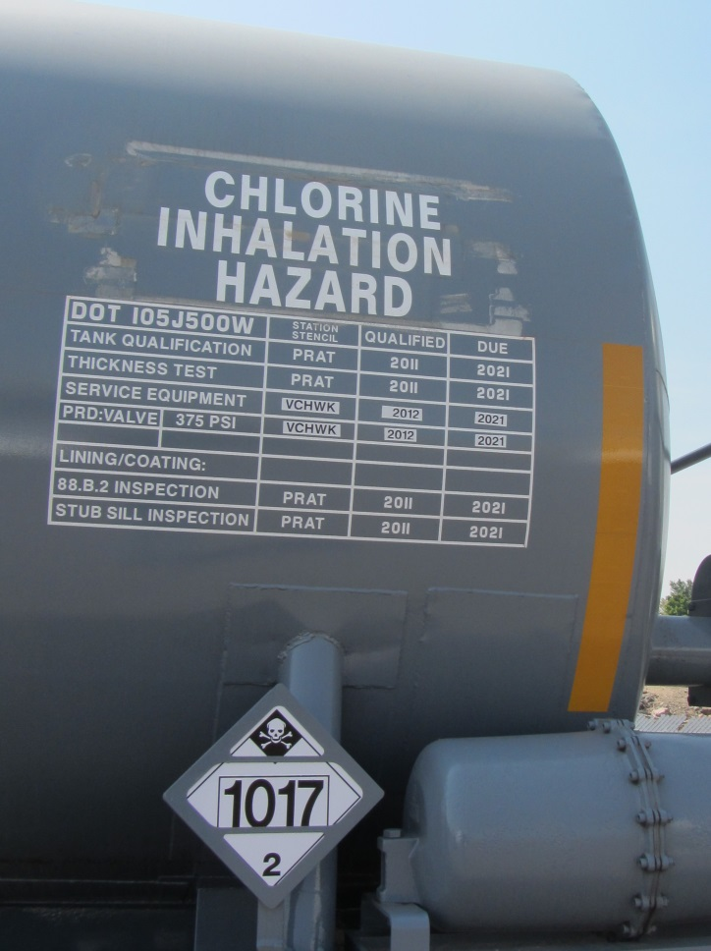
Objectives
Provide knowledge and skills to help you respond to transportation emergencies involving chlorine
  Contacting the railroad
  Railroad resources
  Assessing the incident, using:
    Rail shipping papers
    Markings
  Identifying pressure tank cars for transporting chlorine
Notes:
Review the topics you are going to discuss in this segment . . . what you want the responder to get out of the segment:
Contacting and working with the railroad - Importance of contacting the railroad; how to contact the railroad; what information they need; what resources does the railroad bring to the incident; railroad role in ICS
Assessing the incident - using the shipping papers to identify materials (introduce shipping papers, reporting marks and number)
Identifying pressure tank cars for transporting chlorine - construction features, safety systems, shelf couplers, head shields, thermal protection and jackets, service equipment (valves and fittings)
Assessing tank car damage (using the railroad teams to do damage assessment).

Slide 25
Contacting the Railroad
When notified of a rail emergency:
Contact the railroad using the railroad’s emergency phone number
Make sure the railroad knows about the emergency
Stop trains if necessary
BNSF - 800-832-5452
Canadian National - 800-465-9239
Canadian Pacific - 800-716-9132
CSX Transportation - 800-232-0144
Kansas City Southern - 877-527-9464
Norfolk Southern - 800-453-2530
Union Pacific - 888-UPRR-COP (877-7267)
CHEMTREC - 800-424-9300
CANUTEC - 613-996-6666 (collect)
Notes:
When accidents occur,
Call the railroad and make sure the railroad knows there is an emergency and that you are responding.
You may have gotten a call through 911, but the call may have originated from a private citizen and the railroad may not be aware of the emergency.

Slide 26
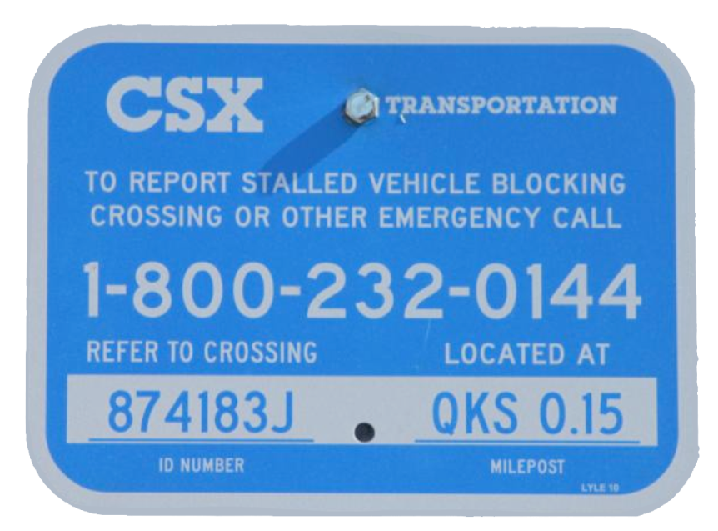
Contacting the Railroad (cont.)
Crossing Sign Information
Ownership
Emergency telephone number
Crossing ID number
Milepost location
Notes:
The crossing sign will contain the following information:
Railroad ownership
Emergency telephone number
Crossing identification number
Milepost location

Slide 27
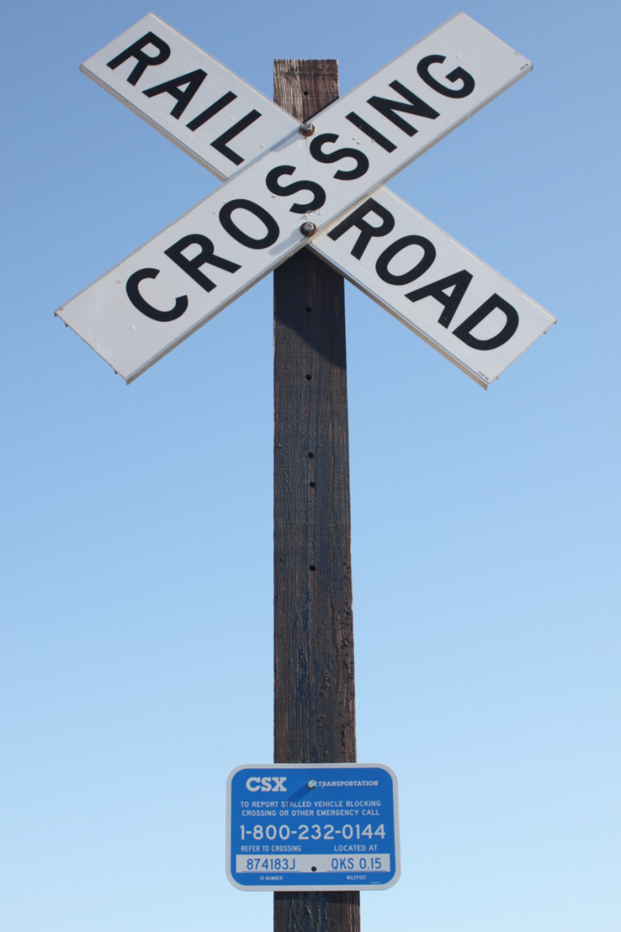
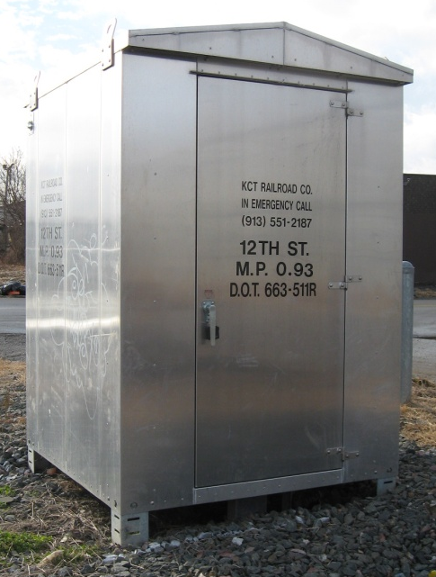
Contacting the Railroad (cont.)
Upon arrival, if at railroad crossing:
Contact railroad emergency center immediately
Give the location of emergency using information printed on signal bungalows or signs at the crossing
Notes:
27
When you arrive on the scene,
Contact the railroad immediately.
Give the exact location of the emergency using information printed on signal bungalows or signs at rail / highway crossings.
Information provided includes:
the railroad who owns the track
the railroad’s 24-hour emergency contact number
the mile post
the US DOT crossing numbers

Slide 28
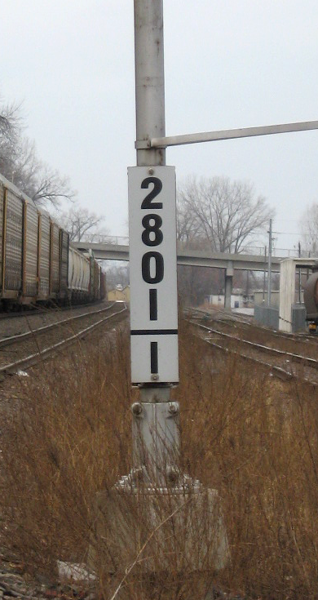
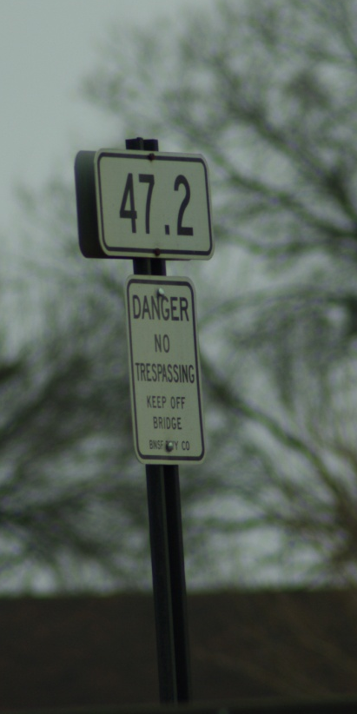
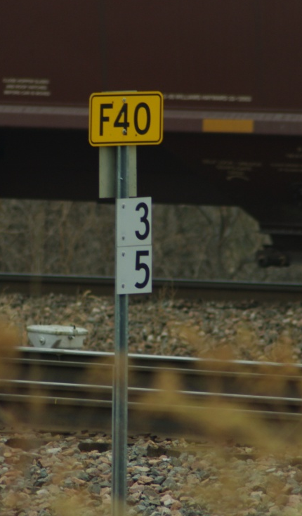
Contacting the Railroad (cont.)
Upon arrival, if between rail crossings:
Look for railroad mileposts in all directions
Give the railroad emergency center your location using the closest rail milepost number in addition to any other location information
If you have GPS, provide your coordinates to the railroad emergency center
Notes:
When you arrive on the scene, and you are in between rail crossing in a rural area
Look for railroad mileposts in all directions.
Give the railroad emergency center the closest rail milepost number you see and any other location information.
If you have GPS capability, give these coordinates to the railroad emergency center.
(Talk about information provided by signs.)

Slide 29
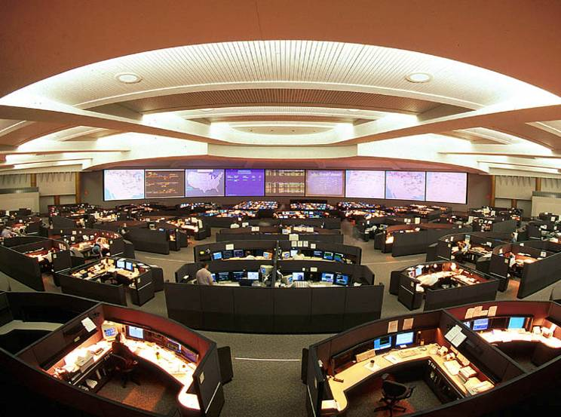

Railroad Resources
Railroad Emergency Center
Stay in contact with the emergency center - you are their eyes and ears
They are staffed 24 hrs/day
They make reports/calls to CHEMTREC®, National Response Center and shippers
They make mandatory notifications to state and federal agencies
Notes:
At the scene,
Be sure to stay in contact with the railroad.
You will be the eyes and ears of the railroad emergency center until railroad responders arrive.
Railroad emergency centers are staffed 24 hours a day. They are typically located along with the primary dispatching center for controlling trains and operations for the railroad.
The railroad emergency center will make continuing reports and calls to CHEMTREC, the National Response Center, and the chemical shippers whose cars are involved in the incident.
The railroad emergency center will also make mandatory notifications and updates to state and federal agencies throughout the incident.

Slide 30
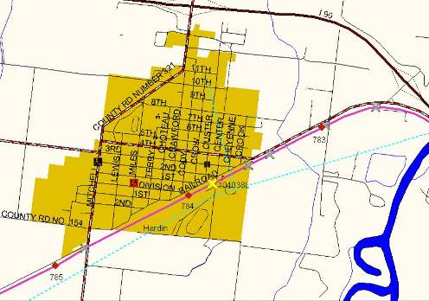
Railroad Resources (cont.)
Geographic Information System (GIS)
Railroad emergency centers may have detailed GIS
  Maps include data on pipelines, infrastructure, soil types, streams, waterways, environmentally sensitive areas, schools, hospitals, etc.
Railroads share this information about handling the incident
HARDIN, MONTANA
Notes:
Many railroad emergency centers have Geographic Information Systems that can provide useful information for responders. For those that do:
Within minutes of a call, the emergency center typically will have detailed maps that likely include information about pipelines, roads and infrastructure, soil types, streams, waterways, environmentally sensitive areas, schools, hospitals, etc.
Railroads work with the Incident Commander and responders.
Railroads share information of what is involved and what resources are en-route to help deal with the incident.

Slide 31
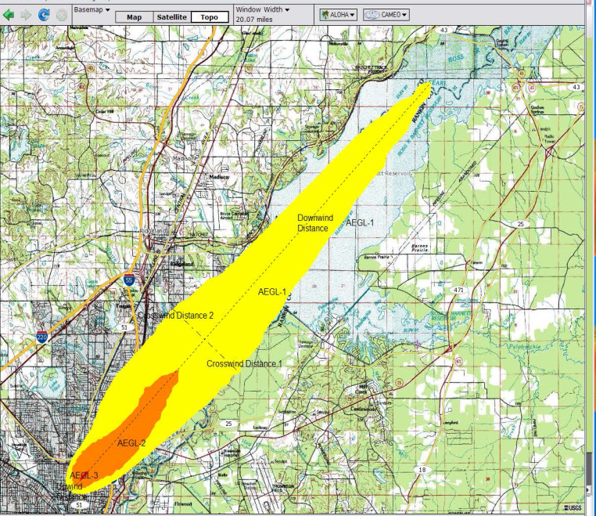
Railroad Resources (cont.)
Plume Modeling
Railroad contractors can provide air dispersion modeling information which can be made available to you by fax or email
Notes:
The railroad emergency response center can also contact contractors and other organizations that can provide plume modeling of suspected or verified hazmat releases. This information can be made available to you by fax or email.

Slide 32
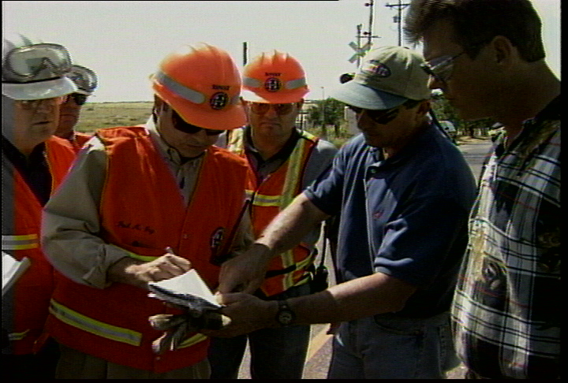
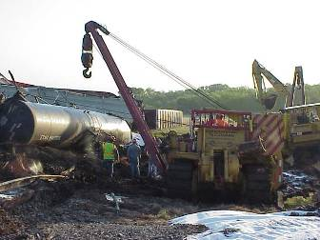
Railroad Resources (cont.)
On-scene railroad personnel
Transportation, mechanical and engineering personnel
Railroad hazardous materials response personnel, police and environmental personnel
Re-railing contractors
Environmental contractors
These railroad personnel will coordinate with the Incident Commander and responders
Notes:
Here are a few of the primary resources the railroad will bring to any major incident.
Managers and personnel from the transportation, mechanical, and engineering departments
Re-railing contractors
Railroad hazardous materials response team personnel, railroad police, and outside contractors
Because of their expertise, hazardous materials response personnel from the railroad can help you assess the damage to the tank car.

Slide 33
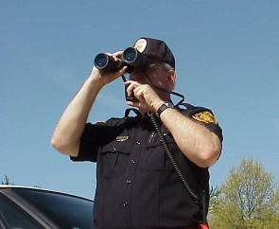
Assessing the Emergency
Size-up carefully - know what you are dealing with
Seek out railroad personnel; ask them about the situation
Get shipping papers from the railroad personnel
Using binoculars from a safe location, look for visible leaks - vapors or liquids
Pay attention to the weather conditions and find out how they may change during the emergency
Notes:
Do a thorough size-up, so you know what you are dealing with.
From a safe location using your binoculars, look to see if smoke or vapor is visible or if any liquids or leaks are visible
Seek out railroad personnel and ask them about the situation.
Get the shipping papers from the railroad personnel.
Pay attention to the weather conditions and find out how they may change as the incident progresses.

Slide 34
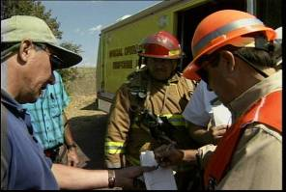
Shipping Papers
Get the shipping papers
Find the train crew - the conductor is responsible for the shipping papers and has the most complete copy on-scene
Ask the crew to share the shipping papers with you and help interpret the information provided
If the train crew is not available, contact the railroad and ask them to fax or email a copy of the shipping papers or read the information over the phone or radio
Notes:
The key to dealing with a hazardous materials emergency is obtaining and understanding the shipping papers.
Find the train crew.
The conductor is responsible for the papers and will have the most complete train list immediately available to you.
The train crew will share the paperwork with and help you read and understand it.
If the crew is not available, call the railroad emergency center and ask them to fax or email you copy of the train list or have them read the information over the phone or radio

Slide 35
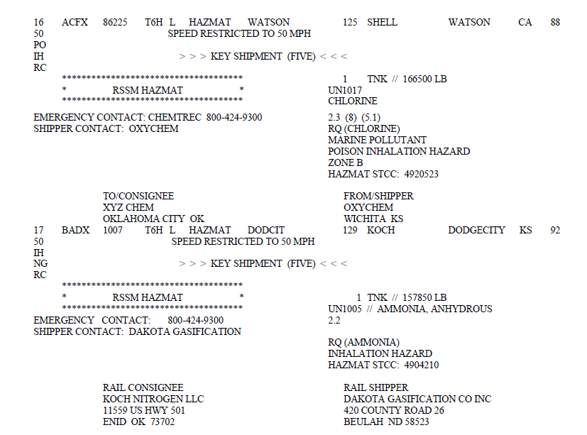
Shipping Papers (cont.)
Shipping papers are the primary safety instrument at a rail emergency.
Shipping papers provide:
Location of each hazardous material (HM) shipment in a train
Description of contents of each HM shipment
Emergency response information for each hazardous material
Notes:
Shipping papers are the primary safety instrument at a rail emergency when hazardous materials are involved. The shipping papers (typically at train list) provides the following information:
Location of each hazardous material shipment in a train
Description of contents of each hazardous material shipment
Emergency response information for each hazardous material

Slide 36
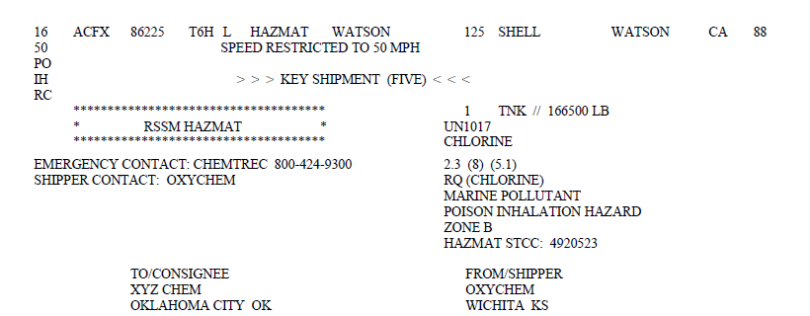
Shipping Papers (cont.)
Key information for each hazardous material on the train:
Line number
Emergency contact number
Reporting marks (initials) and number
Shipping description entries
Notes:
The primary safety instrument at a railroad emergency is the shipping papers.
The train list will show the reporting marks (initials) and number, an indication of Loaded or Empty (L or E) status, an emergency contact number, and the hazardous materials description per the regulations associated with a line number.
Line number – show position of car in train [discuss issue with counting from front or rear of train . . . UP is the odd-ball)
Reporting marks (initials) and number – Cars are identified on the train list by their reporting marks (initials) and number. This car is UTLX 95248. This alpha-numeric stencil is the positive identifier of this rail car. No other rail car in North America will have these initials and numbers. They are like a license plate number. Spot them with your binoculars and match the car to the shipping papers.

Slide 37
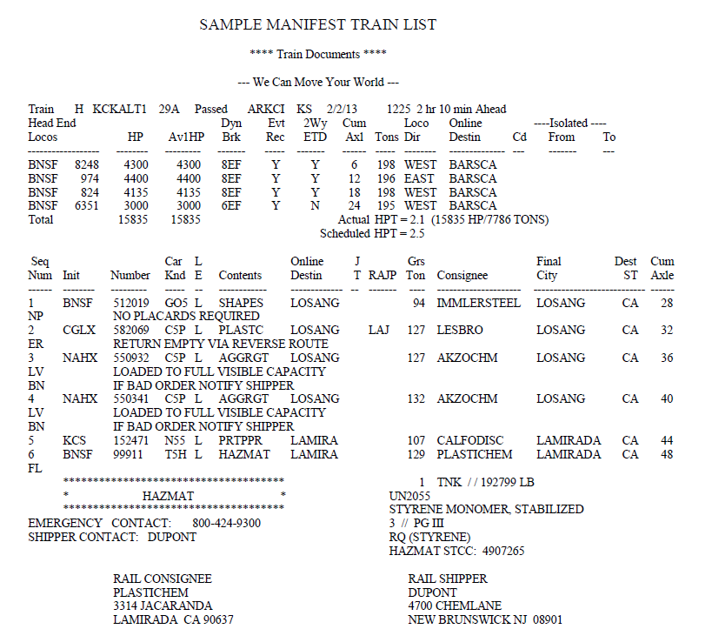
Shipping Papers – Train List
Notes:
If the train’s cars are listed in order from rear to front, the shipping papers will indicate that at the top.

Slide 38
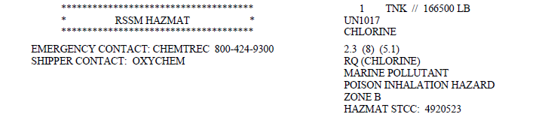
Shipping Papers – Shipping Description Entries
Chlorine Shipments
Notes:
38
Using this graphic, explain the key entries - box of asterisks with or without wording, emergency contact number, total quantity notation, identification number (possibly two locations today), proper shipping name, hazard class (US/Canada), packing group, RQ designation, Inhalation hazard notation, TN notation, shipper contact, hazardous material STCC, shipper/ consignee information if present
Hazardous material shipments are quickly identified on rail shipping papers by the presence of a box of asterisks. Within this hazmat indicator box you may see words such as generic contraction HAZMAT, or words such DANGEROUS, POISON GAS, EXPLOSIVES, or RADIOACTIVE -- or it may be blank.
You will also find an emergency contact telephone number, the rail consignee (who is receiving the shipment) and rail shipper (who shipped the car).

Slide 39
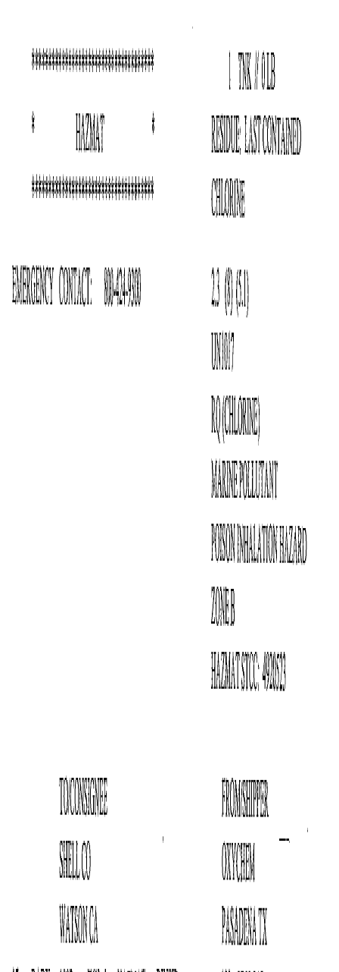
Shipping Papers – Shipping Description Entries
Residue/Empty Shipments of Chlorine
Notes:
Note that the tank car in this example of the entries for a residue chlorine shipment. This car has a small amount of product still in the car that was not possible to unload under normal operations. As this is typical, expect residue tank cars to still have some material remaining.
Look for the line: Residue: Last Contained, preceding the Proper Shipping Name.
The placards applied to residue tank cars will look like a loaded car.
The only way to know if the car is a load or residue is from the shipping paper.

Slide 40
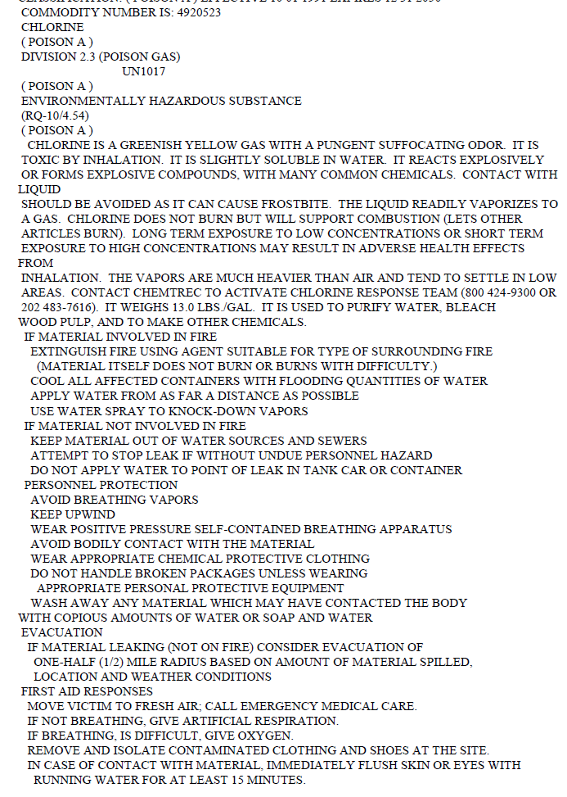
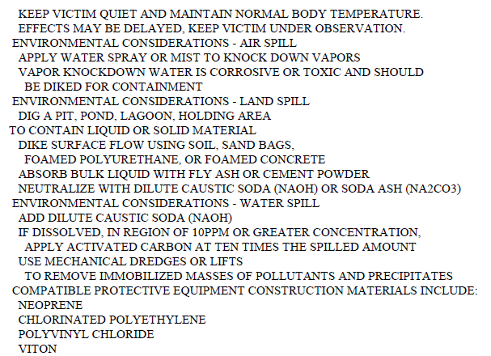
Shipping Papers – Emergency Response Information
Notes:
In addition to the USDOT Emergency Response Guidebook, many US railroads include an emergency response information listing in the train documents. This information is pulled from an industry data file and is presented in clear, easy to read language that is more specific to the material and response than information in the ERG.

Slide 41
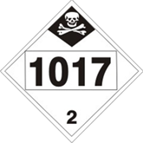
Placards
Notes:
United States regulations require the Class 2 (Division 2.3) poison gas placard for chlorine.

Slide 42
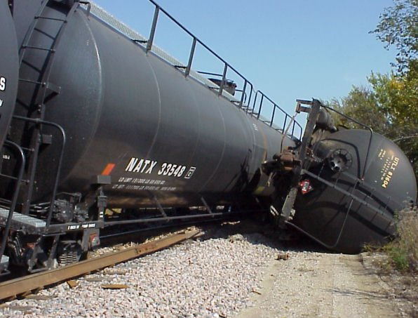
Damage Assessment
Utilize railroad responders to determine damage; they are trained to assess damage to tank cars and other rail equipment
Notes:
Utilize railroad response teams to assess and determine damage to rail cars. The railroad hazmat team is trained to do this kind of work.

Slide 43
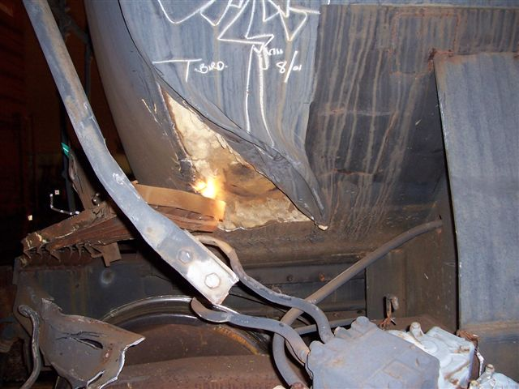
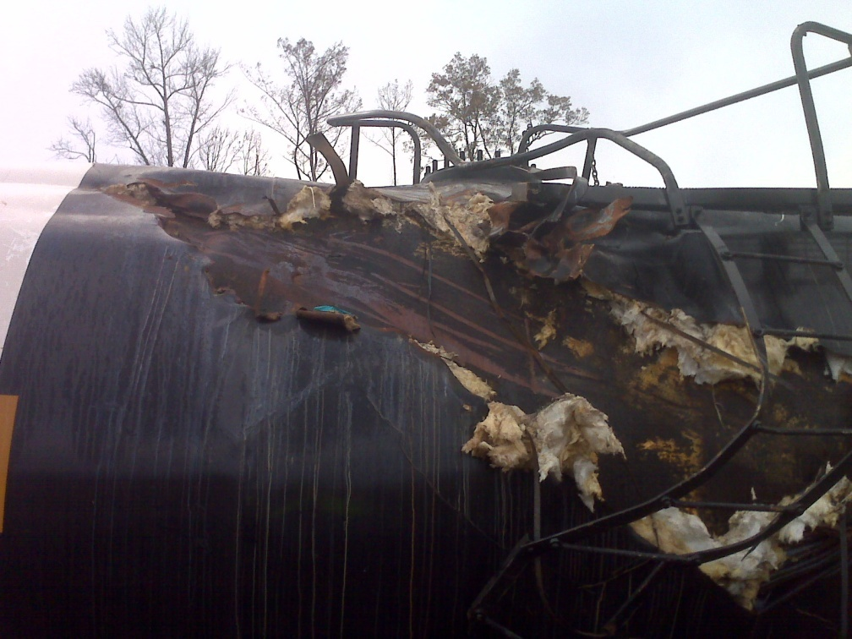
Damage Assessment (cont.)
Jacket damage - not leaking
Notes:
Until the railroad response team is on scene, remember that the large majority of tank cars utilized in North America have an outer wrapper known as a jacket. This thin steel jacket, approximately 1/8 inch thick, holds the insulation and/or thermal protection in place. As you look at the tank car, it may appear to be damaged, but the damage may be to the jacket and not the tank. If you do not see a liquid flowing or pooling or do not see a large vapor cloud, the tank is likely in tact. Utilize railroad responders to do damage assessment on tank cars. These teams will need to get into the incident scene and closely approach the tank cars to determine damage and make decisions on what the appropriate steps are for dealing with the cars involved.

Slide 44
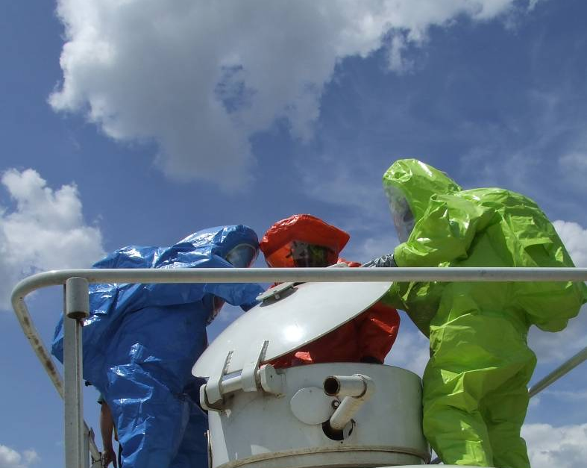
Questions
Contacting the railroad
Railroad resources
Assessing the incident, using:
  Rail shipping papers
  Markings
Identifying tank cars for transporting chlorine
Remember, you are NOT out there alone.
Railroad response personnel are on their way to help.
Notes:
Review the topics you discussed in this segment . . . Ask if there are any questions on what you want the responder to when responding to rail emergencies involving chlorine:
Contacting and working with the railroad - Importance of contacting the railroad; how to contact the railroad; what information they need; what resources does the railroad bring to the incident; railroad role in ICS
Assessing the incident - using the shipping papers to identify materials (introduce shipping papers, reporting marks and number)
Identifying pressure tank cars for transporting chlorine - construction features, safety systems, shelf couplers, head shields, thermal protection and jackets, service equipment (valves and fittings – liquid valves, vapor valves, excess flow and eduction lines, safety valves)
Assessing tank car damage (using the railroad teams to do damage assessment).
Remind students that they are not out there alone . . . Mention that the railroad response personnel are not far away.

