Slide 1
Cylinders & A-Kit Ton Containers & B-Kit
Notes:
This presentation will discuss cylinder and ton container characteristics, potential leak points and emergency containment equipment and techniques.

Slide 2
Chlorine Cylinders
U.S. DOT 3A480 & 3AA480
Several Sizes
100 Pound
150 Pound
20 Pound
Notes:
Smaller cylinders containing approximately 20 pounds of chlorine are normally used by pool applicators and are not as common as the 100 or 150 pound cylinders which are used by a wide variety of end users.

Slide 3
Characteristics: Cylinder
Seamless construction
Metal thickness: 3/16”, empty: 90 lbs
Foot rings: some do, some don’t
Color: not an indicator of product inside
Secure cylinders & prevent toppling (OSHA requirement)
DOT retest date (5 years), stencil outside of cylinder, label in the bonnet
Cylinders: 80% full to allow for expansion
Notes:
Chlorine Cylinders are normally constructed DOT specification as defined in the Department of Transportation Hazmat regulations.

Slide 4
100 Pound Capacity Cylinders
Approximately 65 - 115 pounds empty
Outside diameter 8 1/4” - 10 3/4”
Height 40” - 60”
Contains approx. 8.18 gal. chlorine
Notes:
100 lb cylinder were more common in the past but over the last few decades have mostly been replaced by larger cylinders.

Slide 5
150 Pound Capacity Cylinders
Approximately 85 - 140 pounds empty
Outside diameter 10 1/4” - 10 3/4”
Height from 53” - 56”
Contains approx. 12.27 gal chlorine
Notes:
150 lb cylinders are the most common cylinder in current usage often used by small water treatment facilities such as well houses.

Slide 6
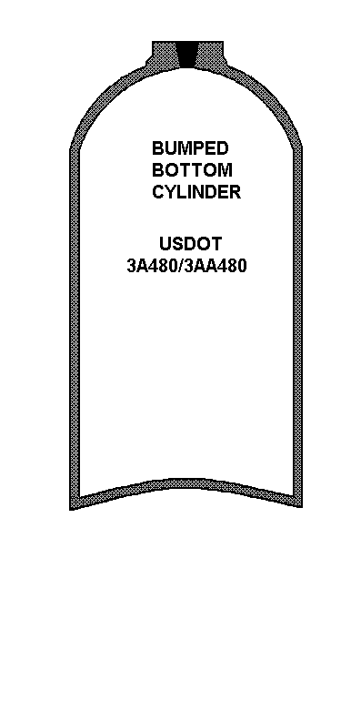
Bumped Bottom Cylinder
Notes:
There are three common cylinder configurations. This slide depicts a cylinder with a bumped bottom.
With all three types response could be to a Hole or Crack on Cylinder Body at Bottom of Cylinder. When this occurs:
Ensure leak Point is in upright position.
Focus leak detection to the foot ring weld area if leak is hard to find (Note: if you can smell chlorine but cannot find a valve leaking look at the foot rings).
This type leak will require a ‘Recovery Vessel’ or a field transfer or need to be field scrubbed. There is nothing in the A –Kit for this type of leak.

Slide 7
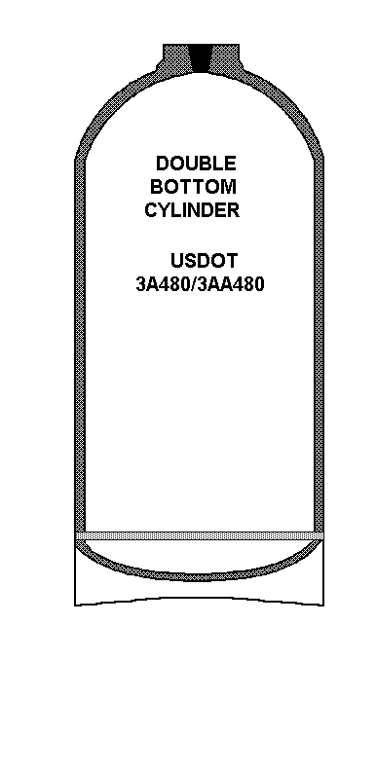
Double-Bottom Cylinder
Notes:
In the case of a double-bottom cylinder the bottom is bumped out and a sleeve welded to the cylinder keeps it upright.

Slide 8
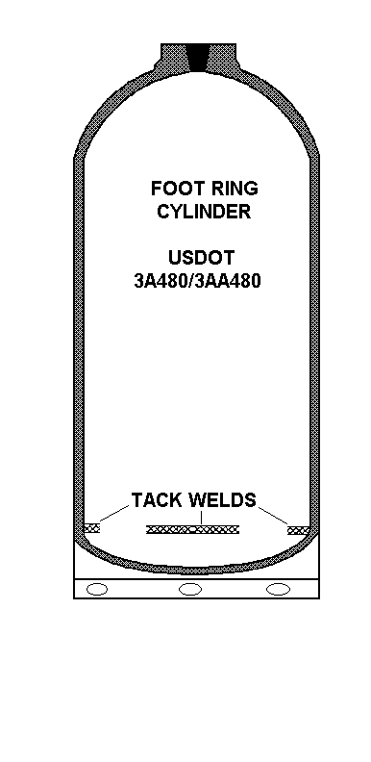
Foot Ring Cylinder
Notes:
The foot ring cylinder is very similar to the double bottom except the weld of the sleeve is a tack versus a continuous weld.

Slide 9
Valve Characteristics
Stem seats in the body of the valve
Open the valve ONE FULL TURN
Packing around the stem, packing nut applies pressure to the packing
Fuse plug melts: 158°F - 165°F
Test pressure after rebuilding the valve is 500 psi
Notes:
CGA 660 valves are normally used on chlorine cylinders. These valves differ from those used on chlorine ton containers in that fuse plugs are incorporated into the valve body.

Slide 10
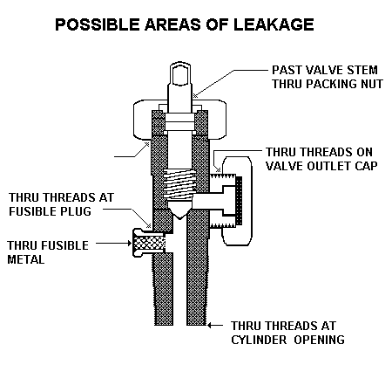
Possible Leak Points on the Valve
Notes:
Always make certain to place the valve in the upright position before attempting to correct a leak.
Leak point: Valve stem; close valve stem and tighten packing nut.
Leak point: Through valve seat; If disconnecting from a process, reconnect and gently open and close valve stem to dislodge foreign matter from seat, then disconnect and apply outlet cap and gasket.
Leak point: Valve outlet cap; close valve stem, tighten cap. If leak continues apply device 1.
Leak point: Fusible plug threads; apply device 1.
Leak point: Fusible plug metal; apply device 2 or 1.
Leak point: Threads at cylinder opening; apply device 1.

Slide 11
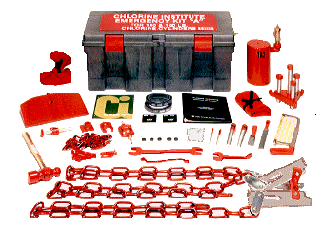
Chlorine Institute Emergency Kit “A” (thru 2012 version)
Notes:
Kit Installation Points To Remember
Always wear Personal Protective Equipment
Normal cylinder pressure < 150 PSI (Closer to 80 -100 psi) Check pressure
Remove all excess paint before attempting to apply the kit
Wipe off any liquids… frost, slime etc…before attempting to apply a kit patch
Use Proper Gasket (Viton for chlorine)
Tighten patch securely and evenly
Don’t get your chains twisted or misaligned
Once you get the leak stopped wait (15 -20) minutes and retighten again if necessary
Even the slightest leak…no matter how small cannot be transported over the road

Slide 12
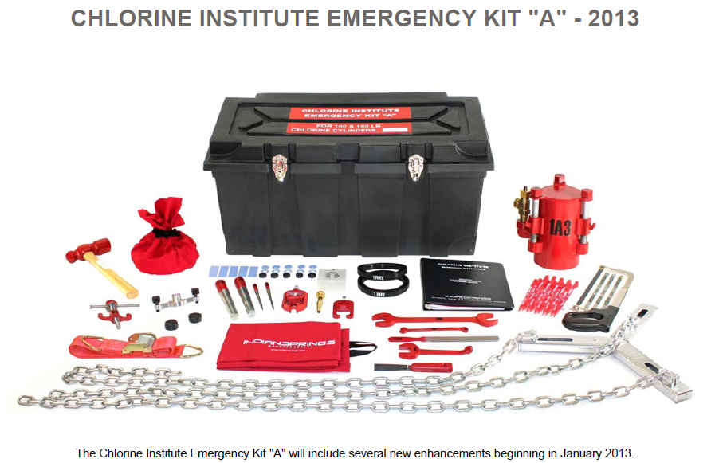
Chlorine Institute Emergency Kit “A” (2013 Version)
Notes:
The Chlorine Institute Emergency Kit “A” will include several new enhancements beginning in January 2013.
Key improvement points:
Improved sealing capability with better gasket design
Easier and faster to apply
Reduced weight

Slide 13
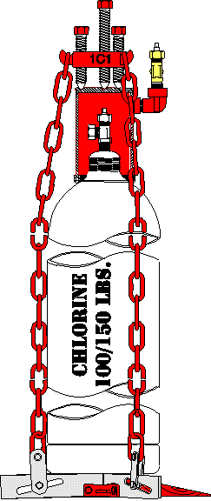
Device 1 Pre-2013
Notes:
Device 1 is used to contain valve leaks. Before applying the hood assembly always remember to OPEN the vent valve for easier application of the hood. Do not over tighten bolts as gasket damage may occur. Also, ensure chains are not twisted and are evenly applied (same amount of links used for all three sides).

Slide 14
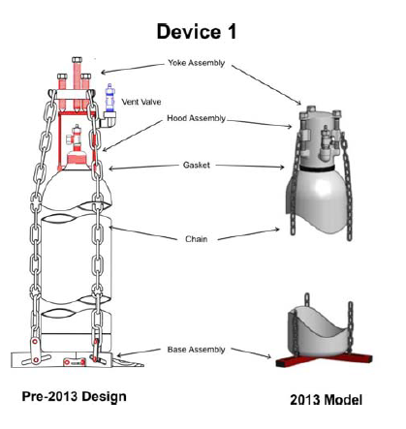
New Design Features 2013
Notes:
2013 enhancements to device 1 as illustrated on the slide.
Key improvement areas:
Hood and Yoke Assembly are now intergraded into one unit. All bolts operate independently allowing for an easier and more efficient application.
Hood outlet valve moved down and out of the way of the Hood bolts.
Hood is backward compatible with current Chain and Base assembly and gasket.
Gasket enhanced to reduce roll-out.
Chain and Base Assembly have fewer components and will be more stable with new flat ramp design.
Chain is smaller and lighter but comparable in strength with current design.

Slide 15
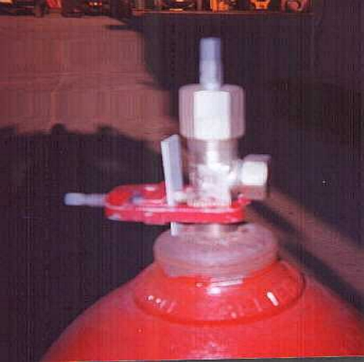
Device 2
Notes:
Remove valve protective housing if in place. Position cylinder so that the valve is in the uppermost position. It is not necessary to remove the valve outlet cap. If, for whatever reason, device 2 installation is unsuccessful (pictured) device 1 can be applied as an alternative.

Slide 16
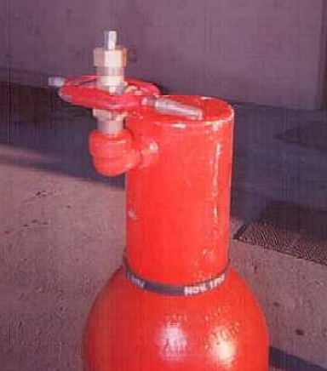
Hose barb
Notes:
Hose barb is part of the kit in the event the hood assembly needs to be vented into a scrubbing solution in the field.

Slide 17
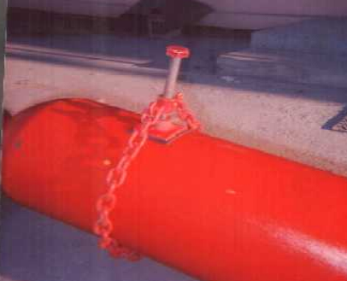
Device 8 Pre-2013
Notes:
Pin Hole in Cylinder Body:
Ensure leak point is in upright position.
Look for unexplained brown liquid trails on cylinder body…they are an indication of pin hole.
Carefully remove excess paint buildup.
Check integrity of steel before applying sidewall patch.
Ensure chain is straight and not twisted.

Slide 18
2013 Enhancements to Device 8
Notes:
2013 Enhancements to Device 8.
The flat patch concept has been replaced with a new circular “button” style patch. Focused design requires 60% less torque to seal than previous flat patch style.
Adjusting screws allow for additional pressure onto leak and stabilization of entire unit.
Bolt no longer requires a wrench but is now hand operated.
Yoke works with current chain or fabric strap.

Slide 19
Emergency Kit Gaskets
Material – Viton ®
Inspect thoroughly
Cuts, nicks, abrasions
Manufacturer defects
Prior usage, age
4 year shelf life
Notes:
It is recommended that the gaskets be inspected on a routine basis as part of the kit’s overall periodic routine maintenance, inspected prior to use and replaced every 4 years.

Slide 20
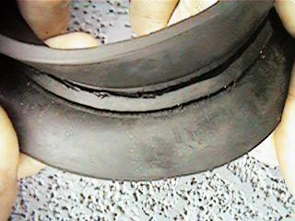
Damaged Gasket
Notes:
Here’s an example of a gasket that should not be used in service due to cuts or “gouging”.

Slide 21
Ton Container Diagram
Notes:
Chlorine Ton Containers are constructed DOT specification as defined in the Department of Transportation Hazmat regulations. These containers are also known as a “multi unit tank car tank” or DOT 106A500X.

Slide 22
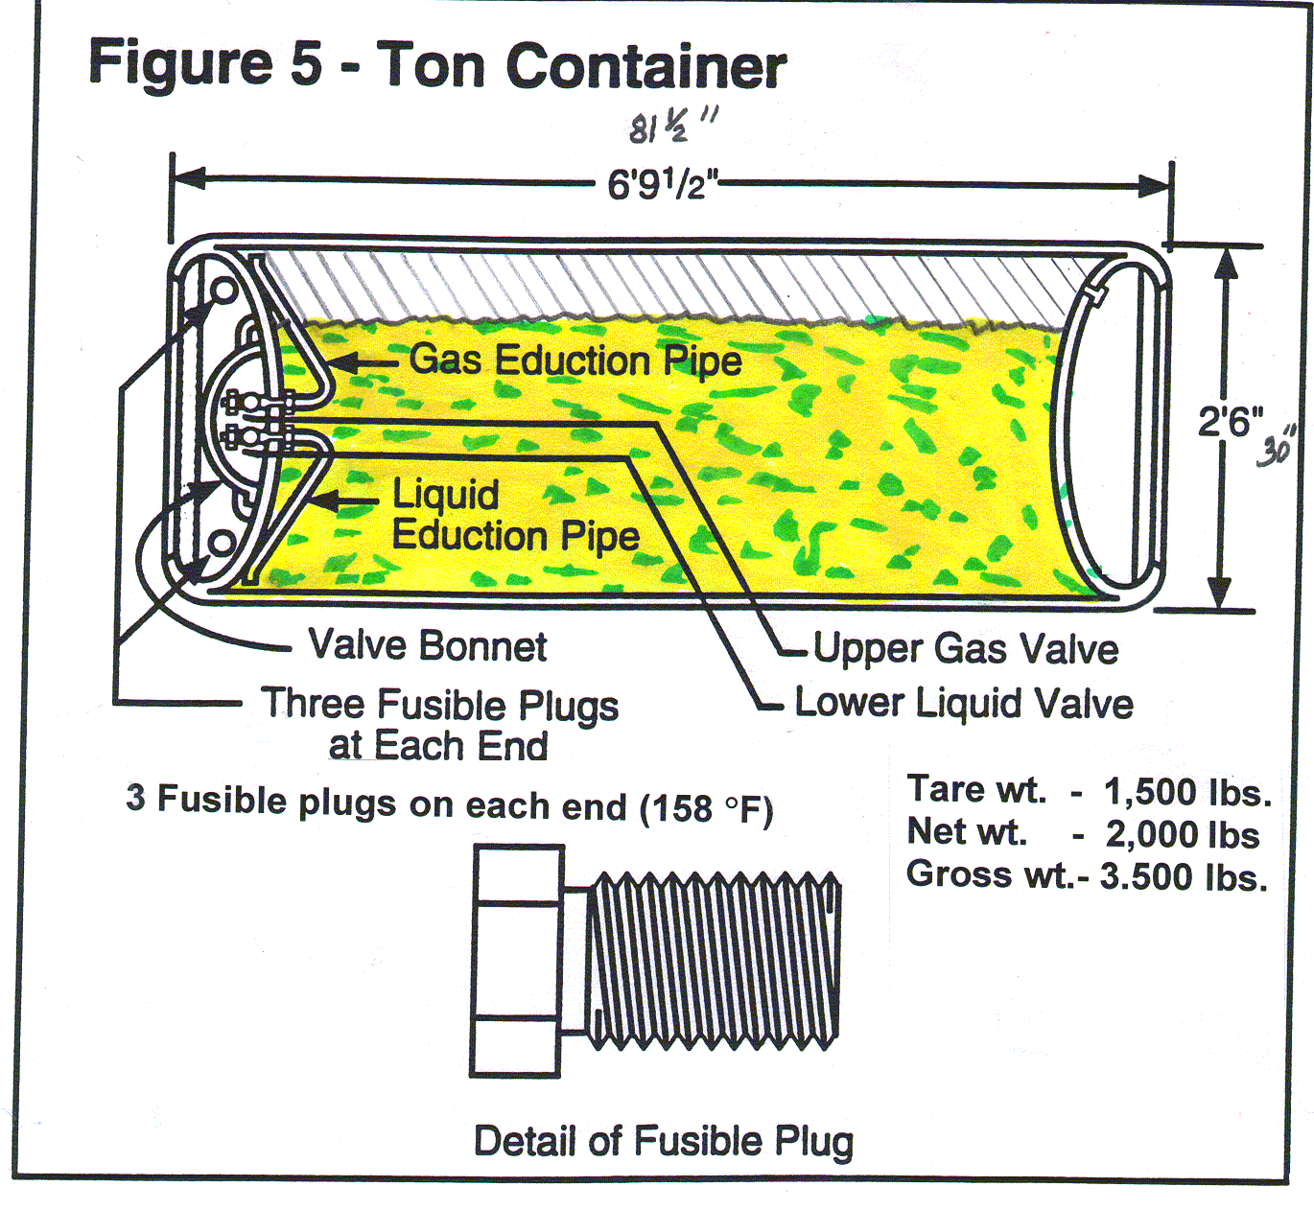
Typical Filled Ton Container
Notes:
A ton container has two valves(CGA 660) ; a gas and liquid valve when the valves are aligned in the 12 (gas) and 6 (liquid) O’clock positions one over the other. The ton also has (6) fuse plugs (3) on each side which are designed to melt at 158 -168° F.

Slide 23
Cutaway of Ton Container
Notes:
This picture of a cut away ton shows the internal eduction pipes.

Slide 24
Ton Container Head Diagram
Notes:
Two valves (top valve is gas and bottom is liquid). Valves are only located on one end of the ton container, whereas 3 fusible plugs exist on each end of the container (6 total).

Slide 25
Container Marking
Specification
Owner’s stamp/serial #
Hydrotest date & inspector’s mark
Water capacity (in lbs)
Original tare weight
Contents label
Notes:
DOT specifies the requirements for marking as depicted. This marking is typically located on the valve end side.

Slide 26
Expanded View of Container Valve
Notes:
Always make certain to place the valve in the upright position before attempting to correct a leak (rotate container so leaking valve is on top “12:00”
position. Its much easier to handle a gas leak versus a liquid leak).
Leak point: Valve stem (packing leak); close valve stem and tighten packing nut.
Leak point: Through valve seat; If disconnecting from a process, reconnect and gently open and close valve stem to dislodge foreign matter from seat, then disconnect and apply outlet cap and gasket.
Leak point: Valve outlet cap; close valve stem, tighten cap. If leak continues apply device 12 (discussed further in slides).
Leak point: Valve inlet threads; apply device 12.
Leak point: Fusible plug threads; apply device 4 (discussed further in slides).
Leak point: Fusible plug metal; apply device 4.

Slide 27
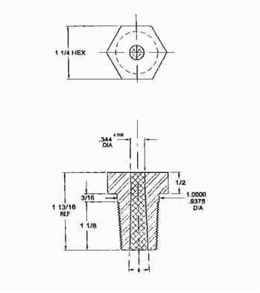
Fusible Plug
Notes:
The fusible is designed to melt out and serve as a pressure relief device for the container before the container would catastrophically rupture in a fire or high heat situation.

Slide 28
Chlorine Liquid vs. Vapor
One volume of liquid chlorine occupies 460 volumes as vapor at atmospheric conditions
Notes:
Points of interest in this photo:
Leak in vapor space.
Frost line.
Chlorine looks like a green fog, low to the ground, descends upon exiting the container.

Slide 29
B-Kit Applied to Valve Leak
Notes:
Points of interest:
Picture of Device 12 application (notice the capped valve is on top; container was rotated so that the leaking valve is in the “12:00” position).
Apply enough force to stop leak, not damage gasket.
Retest for leaks after application.

Slide 30
B-Kit Applied to Fusible Plug
Notes:
Points of interest:
Picture of Device 4 application.
Rust trail from fusible plug indicates probable leak.
Frost line.
Kit applied in vapor space.
Apply only enough force to stop the leak.

Slide 31
B-Kit Applied To Shell Leak
Notes:
Points of interest:
Picture of Device 9 application.
Kit applied in vapor space.
Apply only enough force to stop the leak (do not over tighten as the container wall may be weak).

Slide 32
DOT Specification 110-A Container Example
Notes:
While the DOT 106 is the common ton container specification in North America the DOT 110 specification has been used in the past and some may still be in use. The major difference is the convex head.

