Slide 1
CHLORINE PROPERTIES AND EMERGENCY RESPONSE

Slide 2
Objectives of Presentation
Introduce the Chlorine Institute and CHLOREP
Provide overview of the chemical properties, uses and hazards of chlorine
Provide understanding of how chlorine properties will affect emergency response, including exposure treatment and security concerns
Provide overview of the resources available to you in an emergency
Notes:
We have several goals we will accomplish with this presentation. First, we will introduce the Chlorine Institute and provide a brief history and accomplishments of the Institute. We will explain CHLOREP, its mission, how it works and where it covers.
However, the main goals of this presentation are to provide information and education about chlorine, emergency response considerations and emergency and informational resources.
We will provide you with an overview of the chemical, chlorine – its uses, where it is found, its chemical properties and the health and environmental hazards you may encounter.
We will provide you with an understanding of how the properties of chlorine will affect your response actions, exposure treatments and security concerns. For example, as a first responder, your first instinct may be to apply water to a release of a leaking container. However, you will see that doing this may actually worsen the situation.
We will show you the various chlorine transport and storage containers, how to identify them and differentiate them from other chemical containers, and provide a brief overview of the containment kits used for mitigation.
And finally, we will provide an overview of the resources available to you before and during an emergency. Remember: you are not alone in responding to a chlorine incident. There are many resources able to help.

Slide 3
What is The Chlorine Institute?
Established in 1924
Non-profit trade association
200 member companies worldwide
Focused on improving Safety, Security, Health & Environmental performance in the chlor-alkali chemicals industry
Notes:
Established in 1924, the Chlorine Institute is a non-profit, technical trade association comprised of 220 companies worldwide that safely produce, distribute and use chlorine, sodium and potassium hydroxides, and sodium hypochlorite. Because it is so widely transported and used, it has long been an accepted responsibility of chlorine producers, packagers, distributors and users to promote chlorine’s safe handling, secure transport, effective response methods and the protection of public health and the environment. The Chlorine Institute is the focal point for these combined efforts.

Slide 4
CI Accomplishments
Standardized chlorine containers and valves
Emergency capping kits for chlorine containers
CHLORine Emergency Plan (CHLOREP) Network
Technical & safety-related pamphlets
Educational materials (First Responder DVD)
Works with DOT, OSHA, EPA, and DHS to advance health, environment, safety and security
Notes:
The mission of the Chlorine Institute is to promote the continuous improvement of operational safety, security practices and emergency response within the chlor-alkali industry. One way CI has done this is by working to establish standardized containers, valves and emergency capping kits. Responders should feel confident that the equipment they may encounter in one part of the country, or with one company, will be consistent across the industry.
CI administers and coordinates the Chlorine Emergency Plan, or CHLOREP, which we’ll discuss in a minute.
CI also develops educational tools, such as technical and safety pamphlets, drawings, papers, and videos. A complete list can be found at www.chlorineinstitute.org.
And finally, CI works closely with government agencies – such as the DOT, OSHA, EPA and DHS – to advance safety in a variety of areas.

Slide 5
The CHLOREP Mission
Prepare and educate to assure effective emergency response preparedness, prevention and mitigation of chlorine incidents
Ensure timely and professional response to all chlorine incidents
Notes:
CHLOREP is a volunteer program that provides an organized system for responding to chlorine emergencies in the US and Canada. It operates on a 24-hour, 7 days a week basis. Wherever there is a chlorine emergency, a CHLOREP team can provide assistance at the scene – this assistance can range from providing telephone instruction to the personnel on the scene, to providing expert assistance at the emergency site. A CHLOREP team consists of employees of various member companies and is supplemented by a network of emergency response contractors.
CHLOREP’s mission is to provide effective emergency response preparedness, prevention and mitigation through education, and to ensure timely and professional response to all chlorine incidents.

Slide 6
Strategy to Accomplish Mission of CHLOREP
Assist in responding to state and local requests for chlorine emergency response training
Provide training opportunities for CHLOREP Team Members
Provide complete CHLOREP coverage of the U.S. and Canada
Maintain Emergency Response Contractor Verification Program
Notes:
CHLOREP accomplishes its educational mission in several ways:
- by assisting in responding to state and local requests for chlorine emergency response training;
- by providing training opportunities for CHLOREP team members;
- by providing adequate coverage in assisting responders in all parts of the country;
- and by maintaining a contractor verification program to ensure all members are fluent in effective response procedures.

Slide 7
CHLOREP Sector Map
Notes:
CHLOREP teams are assigned a sector within a state, or several states or provinces in Canada. The way a CHLOREP activation works is like this: you are involved in a chlorine emergency in your area. You call CHEMTREC (if you’re in the US) or CANUTEC (if you’re in Canada) for assistance. These dispatch agencies will telephone the designated CHLOREP emergency contact, who then notifies the CHLOREP team leader in your sector. He or she, in turn, telephones the emergency caller at the scene – in this case, you – and determines what advice and aid are needed, which may or may not include dispatching a specialized team to the scene.

Slide 8
CHLOREP Level III ER Contractors (as of summer 2013)
Specialized Response Solutions (SRS)
United Professional Services (UPS)
United States Environmental Services (USES)
Notes:
Here is a list of the CHLOREP Level three emergency response contractors. These contractors have specialized expertise in handling chlorine emergencies including emergency field transfer from damaged containers to containers safe to transport. The Chlorine Institute and its members have verified that these contractors do have experience with chlorine and related chemicals.

Slide 9
CHLOREP Level II Canadian Service Providers (as of summer 2013)
Envirotec Services, Inc.
iTech Precision Cleaning, Inc.
Newalta Corporation Emergency Response
Quantum Murray LP
Notes:
Here is a list of the CHLOREP emergency response contractors in Canada. These contractors also have expertise in handling chlorine emergencies and, while CI has verified they have experience with chlorine emergencies, we have not reviewed their experience related to field transfers.

Slide 10
Chlorine Introduction

Slide 11
Chlorine is Essential
Critical Chemistry: integral component to the manufacture of thousands of everyday products
Safe and disease-free drinking water
Used to produce 93% of top-selling U.S. pharmaceuticals and medicines
Used as germ-destroying disinfectant in homes, healthcare and daycare facilities, restaurants, etc.
Used to produce 86% of crop protection chemicals and herbicides
Used directly in about 40% of U.S. industries; indirectly in virtually ALL U.S. industries
Production of many plastics (vinyl, PVC, etc.) which contribute to improved standard of living
Used in renewable and clean energy, as well as recycling industry
Notes:
We call the use of chlorine “critical chemistry” – it is a critical component used in manufacturing thousands of everyday products, and is used to keep our environment safe and disease-free, such as disinfecting our drinking water. It is used in the production of 93% of the top-selling medicines in the US. It is the leading disinfectant in homes, hospitals, healthcare and daycare facilities, restaurants and more. It is used in agriculture to produce 86% of the chemicals and herbicides that protect our crops. Chlorine is used in the production of many types of plastic materials we take for granted every day, and is used in the renewable, clean energy and recycling industries. It is estimated that about 40% of all US industries use chlorine directly in their operations, but virtually ALL US industries use chlorine indirectly.
You can see that because chlorine is so essential to our lives, it’s no surprise that chlorine is also one of the most common chemicals transported through our communities. So the need for an effective, rapid emergency response network is critically important.

Slide 12
Uses of Chlorine

Slide 13
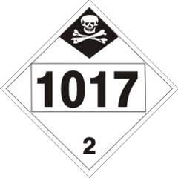
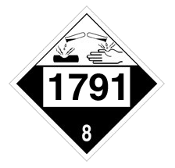
Chlorine vs Bleach
Strong, pungent bleach-like odor
Industrial use – shipped as compressed liquefied gas
Lethal exposure risk
Chemical name: chlorine
Bleach odor
Household use – aqueous solution (some similar solids)
Moderate irritant
Chemical name: sodium hypochlorite
“Chlorine Bleach” is NOT Chlorine!
Notes:
You may think there are some similarities between chlorine and bleach – and in fact, you may have heard bleach being referred to as “chlorine bleach.” But is it critical that you understand that bleach is NOT chlorine.
First, they are placarded differently. Chlorine is classified as a class 2 inhalation hazard gas – bleach is classified as a class 8 corrosive. One of the first things you need to assess upon arriving at an incident is the chemical involved, which will dictate what type of response plan you will activate. This is especially important when it comes to PPE – a class 2 is much different than a class 8. We will review proper PPE in more detail in a bit.
Chlorine has a very strong, pungent, bleach-like odor. It has a low odor threshold, around 0.2 to 3.5 ppm, meaning that it does not take a lot to alert you that chlorine is present.
Chlorine is shipped as a compressed liquefied gas. The only times it arrives at a customer’s facility is gaseous form is when it is a direct pipeline. Household bleach is always an aqueous solution. Some chlorination compounds, such as calcium hypochlorite, are shipped in solid form.
Chlorine has exposure limits and can easily be lethal. Exposure to bleach is general not as catastrophic.

Slide 14
Chlorine Properties (liquid)
Clear amber color
1.5x heavier than water
Becomes a solid at -150º F (freezing point)
Becomes a gas at -29º F (boiling point)
High coefficient of expansion; 1 volume expands to approx. 460 volumes in gas phase
Has a vapor pressure at temperatures above its boiling point, which increases rapidly with increasing temperature
Liquid chlorine at atmospheric pressure is very, very cold
Notes:
Liquid chlorine has a clear, amber color. It is 1.5 times heavier than water. One important fact to keep in mind about chlorine – and this will come into play during rescue and exposure treatment – is that liquid chlorine is a very, very cold substance. Its freezing point is minus 150-degrees F and its boiling point – or the point at which it becomes a gas – is minus 29-degrees F. Compressed liquefied chlorine gas will quickly cool to this boiling point once it reaches atmospheric pressure, as when the container is opened or ruptured. This is known as “autorefrigeration.”
Liquid chlorine has a high coefficient of expansion, meaning it takes a very little bit of liquid to make a lot of gas. Weather and temperature may affect this equation, but a good rule is 1 volume of liquid chlorine will expand to about 460 volumes of chlorine gas.
Chlorine exhibits vapor pressure at temperatures above its boiling point – in other words, whenever the temperature gets above minus 29ｺ F, gas pressure will begin to form. And this pressure will increase rapidly as temperature increases.

Slide 15
Chlorine Properties (gas)
Faint yellowish color at low concentrations
Green/yellow at high concentrations
2.5x heavier than air
Will settle and concentrate in low places and inside of buildings
Not visible below approx. 25 ppm (dependent on humidity)
Gas pressure of chlorine inside a container is directly proportional to temperature of the gas
Do not spray water directly on a leak - water and chlorine combine to be very corrosive to steel and could make the leak worse
Notes:
Chlorine gas exhibits a faint, yellowish color at low concentrations, but will be green to yellow/green at high concentrations. It is 2.5 times heavier than air, meaning chlorine gas has a tendency to settle in low lying areas, like ravines and trenches, and towards the floor inside buildings.
Chlorine gas is typically not visible below about 25 ppm (this is dependent on humidity), but remember it has a low odor threshold of about .2 to 3.5 ppm – you may smell it before you see it, under certain conditions.
Chlorine gas has a direct pressure/temperature relationship, meaning as temperature rises, so does the pressure. This is critical knowledge when you come upon a leaking chlorine container. Your first instinct may be to put water on the container, but what are you actually doing? Water out of the fire hose is about 60 degrees F (what’s the exact temp?). When you apply that water to a container that has substance inside with a boiling point of minus 29 degrees F, you are raising the temperature of that substance. And when you raise the temperature of chlorine, you are raising the gas pressure. It is acceptable to cool an overheated container that is sealed (not leaking). It is never a good idea to spray water directly on a leak because water and chlorine combine to be very corrosive to steel and you could make the leak worse. *Unless there is fire involved.

Slide 16
Chlorine Reactivity
“Wet” chlorine is very reactive and corrosive to most metals
“Dry” chlorine is compatible with most metals, except titanium, aluminum, and tin
“Wet” and “Dry” refer to the moisture or water content in the chlorine gas and “wet” does NOT mean chlorine bleach.
Reacts violently with steel at temperatures above 450º F (232º C)
Can support combustion above 480º F (250º C)
Notes:
As this video shows, chlorine is highly reactive with certain materials. Wet chlorine is very reactive and corrosive to most metals.
Dry chlorine is compatible with most metals except titanium, aluminum and tin.
Chlorine reacts violently with steel at temperatures above 450 degrees F and can support combustion at about 480 degrees F. These are all facts that you should keep in mind when responding to a chlorine incident where fire is involved.

Slide 17
Chlorine Reactivity Video
Notes:
Chlorine Reactivity Video – 1:17

Slide 18
Chlorine Reactivity
Chlorine reacts violently with substances such as greases, oils, paints, some solvents, etc.:
Acetylene
Hydrogen
Anti-seize compounds
Hydrocarbon oils and greases
All silicone based greases and oils
Detergents and soaps
Ammonia (creates nitrogen trichloride)
Finely divided metals (copper, iron)
Activated charcoal
Notes:
As we saw in the previous video, chlorine reacts violently with greases, oils, solvents, etc. Here are some common substances that will cause a violent reaction when chlorine comes into contact.

Slide 19
Dissipation of Chlorine Gas
Notes:
Here we will watch a short video (about a minute and a half) that shows the release of one ton of chlorine in Dugway, Utah. The tank is situated in a shallow basin. We will watch the first minute which is all it takes for the liquid chlorine to be expelled from the bottom of the tank, then we will see the gas cloud at about 5 minutes after the start of the release, 10 minutes, then 30 minutes after the release.
<<click to play video>>
This is one ton of liquid chlorine released from a 2-inch valve at the bottom of the tank. You can see the immediate flashing of chlorine vapor, we already talked about the low boiling point of chlorine. You can see the liquid spraying at fairly high pressure from the valve, the chlorine stays fairly low to the ground and dissipates in the direction of the wind.
<<at the 1st transition>>
Now, here it is five minutes after the start of the release, only four minutes after the tank emptied. You can see the cloud has already gotten much smaller, you can also see that it remains in the low area of the basin.
<<at the 2nd transition>>
Here is 10 minutes in and you can see it has dissipated a bit more, than at five minutes, but there is still quite a bit of ‘color’ left in the basin. We said previously that you can see it at around 25 ppm, depending on conditions, so this is a higher concentration than that.
<<at the 3rd transition>>
Now, 30 minutes after the start of the release, you can no longer see any chlorine in the area. That does not mean it’s safe to approach without respiratory protection, but it does show us that chlorine gas clouds begin to dissipate as soon as the release is stopped, so that should be our first priority: stopping the release. Next, we’ll see another video…

Slide 20
Heavier than Air versus Lighter than Air Gases
Chlorine
Ammonia
Notes:
This video will show the differences in behavior between heavier-than-air and lighter-than-air gases. The video on the left is chlorine gas, which we have already discussed is heavier-than-air, and the one on the right is ammonia, which is lighter than air. <<click to start video>> Here you can see that, though the chlorine does rise, it does not rise as high as the ammonia, which is about half as dense as air.

Slide 21
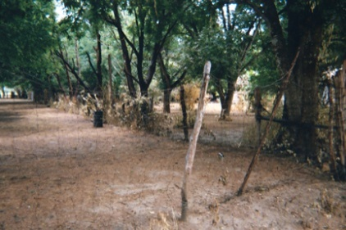
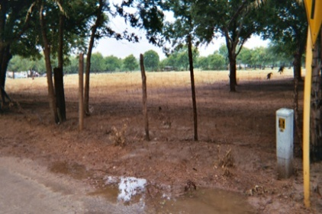
Environmental Hazards of Chlorine
Chlorine is not a naturally occurring chemical
Mixing with water may form hydrochloric acid
Causes bleached spots on leafy plants; usually does not kill the plant but yield may be affected
Inhalation effects on animals are similar to humans (dead animals may indicate chlorine)
Water solubility is 6.93 lbs/100 gal of water; concentrations below 0.1 ppm adversely affects fragile aquatic life
DOT lists chlorine as marine pollutant
Notes:
When we talk about the hazards of chlorine, there are two basic kinds: health hazards, which we will address in a minute, and environmental hazards.
Chlorine is found in nature bound to other elements, primarily in salt or sodium chloride, which is common table salt.
When chlorine mixes with water, hydrochloric acid may form. This is important to keep in mind during your response. Your first inclination may be to put water on a leaking container – as we saw earlier, this raises the temperature of the gas, which raises the pressure. But by putting water on the chlorine source, you may be creating hydrochloric acid, which can run off into the surrounding area, waterways or storm drains. Worse, it is extremely corrosive to the steel used in chlorine containers and it may make the leak bigger very rapidly.
When you approach a scene, there may be environmental cues that you can use to determine if chlorine has been released. On leafy plants like trees and grass, chlorine can cause bleached spots or burns. The inhalation effects on animals are similar to those on humans – dead animals at the scene may indicate chlorine is present.
Very low concentrations of chlorine in water adversely affect aquatic life. The DOT lists chlorine as a marine pollutant. So again, it is critical that you try to keep chlorine, and any water you may have used near chlorine, out of storm drains.

Slide 22
Acute Exposure to Chlorine
What are the hazards of chlorine?
Toxic gas: respiratory tract and eye irritant
Corrosive: chemical burns
Strong oxidizer: heat-related burns
Liquid is very cold: frostbite
What is the odor threshold for chlorine?
As low as 0.25 ppm, varies from person to person
Exposure to respiratory system is primary concern, followed by eye exposure
Impact of exposure effects dependent on both chlorine concentration and length of exposure time
Notes:
Our primary concern in an emergency is the protection of human life. So what are the health effects of chlorine exposure?
Chlorine is a toxic gas and primarily considered a respiratory tract and eye irritant.
Chlorine is also corrosive – getting it on your skin can cause chemical burns.
Being a strong oxidizer, there is the risk of heat-related burns if chlorine becomes reactive.
And remember that chlorine is very, very cold, so there is the risk of thermal burns, or frostbite, from exposure to chlorine.
But chlorine has a low odor threshold – about 0.2 to 3.5 ppm for an average person with normal respiratory health – so it has an effective built-in early detection system.
We are primarily concerned with respiratory system exposure, followed by eye exposure. What is that? Remember that when chlorine comes into contact with water, hydrochloric acid may be formed. What are our bodies mostly made of? Water. If enough chlorine gets into the nose, throat, lungs – the mucous membranes - hydrochloric acid can begin to form.
The impact of any exposure is dependent on the concentration of the chlorine and the length of time the person is exposed to chlorine.

Slide 23
Chlorine Exposure Limits
What are the exposure limits for chlorine?
ACGIH-TLV: 0.5 ppm (8-hr Time-weighted Average)
OSHA-PEL: 1 ppm (Ceiling)
ACGIH-TLV-STEL: 1 ppm (Short Term Exposure Limit)
What is the IDLH for chlorine?
10 ppm
Is chlorine a carcinogen?
Not considered to be carcinogenic by OSHA, NIOSH, NTP, IARC or EPA
Notes:
Here are the official exposure limits for chlorine. (read slide) It is important to note that chlorine is not considered a carcinogen. In fact, except in lethal doses, most people exposed to chlorine, and have received prompt treatment, will fully recover.
ACGIH – American Conference of Governmental Industrial Hygienists
TLV – Threshold Limit Value
OSHA – Occupational Safety & Health Administration
PEL – Permissible Exposure Limits
NTP – National Toxicology Program
NIOSH – The National Institute for Occupational Safety & Health
IARC – International Agency for Research on Cancer
EPA – Environmental Protection Agency

Slide 24
Acute Chlorine Exposure and Estimated Clinical Effects
0.2-3.5 ppm - odor detection
1-3 ppm - mild mucous membrane irritation, tolerated up to 1 hour
5-15 ppm - moderate irritation of the respiratory tract
30 ppm - immediate chest pain, vomiting, dyspnea, cough
40-60 ppm - toxic pneumonitis and pulmonary edema
430 ppm - lethal over 30 minutes
1000 ppm - fatal within a few minutes
Information on this slide is from Ellenhorn, M.J. and D.G. Barceloux. 1988. Chlorine, Chpt. 34: Airborne Toxins. In: Medical Toxicology: Diagnosis and Treatment of Human Poisoning. [Ellenhorn, M.J. and D.G. Barceloux, Eds.] Elsevier, New York. pp. 878-879.
Notes:
You can see from this chart that it doesn’t take a lot of chlorine concentration to cause serious injury to health. At about 30 ppm, serious adverse effects begin to occur. But again, the odor detection limit – the early warning – is below the limits that would affect health. Unless someone is suddenly overcome, or is unconscious, they should begin to smell it and will probably take action.

Slide 25
Treatment of Exposures
INHALATION
Rescuers wear an SCBA and have protective clothing
Remove victim to fresh air without delay
For minimal exposure (with minor burning of nose, throat, eyes, respiratory track and cough) - no specific treatment other than removal from chlorine atmosphere
Victims normally will be symptom free within an hour or less
Due to possible delayed pulmonary effect, they should receive medical attention and be observed for several days
Notes:
First and foremost, emergency responders must wear proper PPE, which includes SCBA and protective clothing. When you come across a victim who has an inhalation exposure to chlorine, move them to fresh air as quickly as possible. For minimal exposure, there is no specific treatment other than get them out to fresh air and away from potential re-exposure due to shifting weather. At low dose exposures, victims usually will be symptom free within an hour. But chlorine does have a delayed effect – victims should receive medical attention regardless of exposure amount and should be monitored for several days.

Slide 26
Treatment of Exposures
INHALATION (cont.)
For more severe symptoms (tightness in chest, dyspnea, persistent cough, anxiety) must treat with oxygen and other supportive measures
Move victim to fresh air - get medical attention
Monitor for respiratory distress
Emergency airway support and 100% humidified supplemental oxygen with artificial respiration may be needed
Remove contaminated clothing and wash skin with plenty of water
Transfer to hospital or emergency medical facility
Notes:
For a more significant exposure – as evidenced by chest tightness, dyspnea, persistent cough and anxiety – oxygen therapy and other supportive measures are required. Move the victim to fresh air and get immediate medical attention. Monitor for respiratory distress. Emergency airway support due to possible swelling may be necessary as well as 100% humidified supplemental oxygen with artificial respiration. Here is where you will want to use water – remove contaminated clothing and flush skin with plenty of water. Transfer the victim to the hospital or nearest emergency medical facility.

Slide 27
Treatment of Exposures
SKIN CONTACT
Wash skin with water
Remove contaminated clothing and wash skin with water thoroughly
If irritation persists after irrigation, or if skin is broken or blistered, get medical attention promptly
EYE CONTACT
Wash eyes with large amounts of room temperature water for at least 15 minutes
Lift the lower and upper lids
Get medical attention immediately. Victim should be examined by an ophthalmologist. Contact lenses should not be worn when working with chlorine
Notes:
If chlorine has come in contact with skin, wash their skin with plenty of water. Remove contaminated clothing and flush skin with water. However, remember that chlorine is very cold and the victim may have thermal burns. If liquid chlorine is splashed onto clothing, the clothing may freeze to the skin – removal of their clothes MAY remove the frozen skin. Be very careful and use plenty of water first. Get medical attention immediately.
If the eyes have been exposed to chlorine, wash the eyes with large amounts of room temperature water for at least 15 minutes. Use an eye wash station if it is nearby and in a safe area. Lift the lower and upper eyelids to make sure all chlorine is flushed out. Get medical attention immediately. An ophthalmologist should also examine the victim after contact. Contact lenses should not be worn when working with chlorine.

Slide 28
Pamphlet 65: PPE Recommendations
Criteria to be met first:
Substance identified as chlorine
Determine if other chemicals are involved
Knowledge of Emergency Response Planning Guidelines (ERPG’s) for chlorine
Trained and experienced employees
Develop site safety plan
Incident commander is in charge
Notes:
28
The Chlorine Institute Pamphlet 65 describes in detail the approved level of dress and personal protective equipment necessary to safely respond to a chlorine incident. But before any response can be launched, there are certain criteria that must be met to ensure that proper PPE is being used and responders lives are not compromised. First, the substance involved must be identified as chlorine and that no other chemicals are involved. Knowledge of the Emergency Response Planning Guidelines for chlorine is essential to help anticipate health effects caused by exposure. Employees at a fixed facility should be trained and experienced in chlorine containment. The site safety plan should be accessed and the incident commander should be on site and in charge. Pamphlet 65 can be obtained by going to the Chlorine Institute’s website.

Slide 29
Considerations and Decisions (gas vs. liquid)
GAS
Self-Contained Breathing Apparatus (SCBA), positive pressure
Level B self-sealing suit or chemical tape on hands/feet openings
Not qualified for confined spaces
LIQUID
SCBA, positive pressure
Enhanced Level B
Chemical protective suit
Footwear cover
Hood for head/neck protection
Thermal underwear
Notes:
29
The level of dress when responding to a chlorine incident will be dictated by what kind of leak is occurring: gas or liquid.
For a gas release, proper PPE includes Level B with a self-sealing suit, or chemical tape securing the openings for hands and feet. However, this is not qualified for confined spaces – need a higher level of protection.
For a liquid release or confined space, proper PPE includes Enhanced Level B with positive pressure SCBA, a chemical protective suit, footwear cover, a hood for head and neck protection, and thermal underwear to protect against chlorine’s extreme cold.

Slide 30
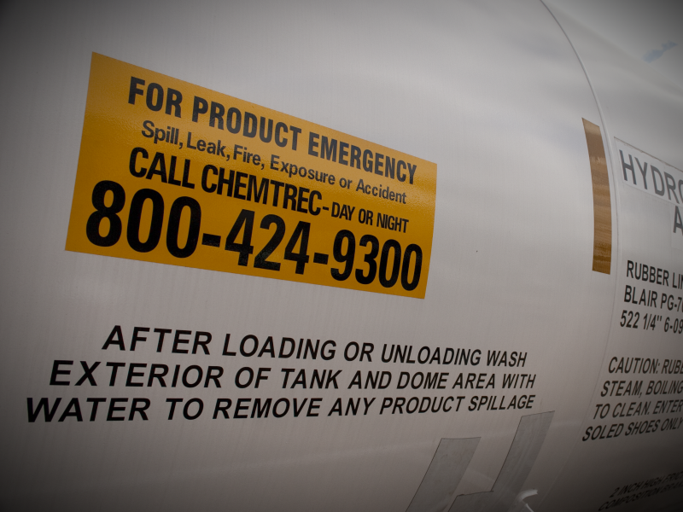
Emergency Information
Safety Data Sheet (SDS)
CHEMTREC
Manufacturer
Transporter
Notes:
30
One thing you need to keep in mind: you are not alone out there when it comes to a chlorine incident. There are numerous resources available to you when you are on the scene. The MSDS for chlorine will provide a wealth of information about the chemical and response considerations. You can call CHEMTREC, who will assist you with information and connect you with appropriate resources. They can also activate CHLOREP, the chlorine emergency plan. Look for company names and emergency contact phone numbers on transports – by law, they must provide an emergency contact number on their transports. If the containers are damaged so much that the number is obscured, call CHEMTREC – keep their number handy or better yet, memorize it.

Slide 31
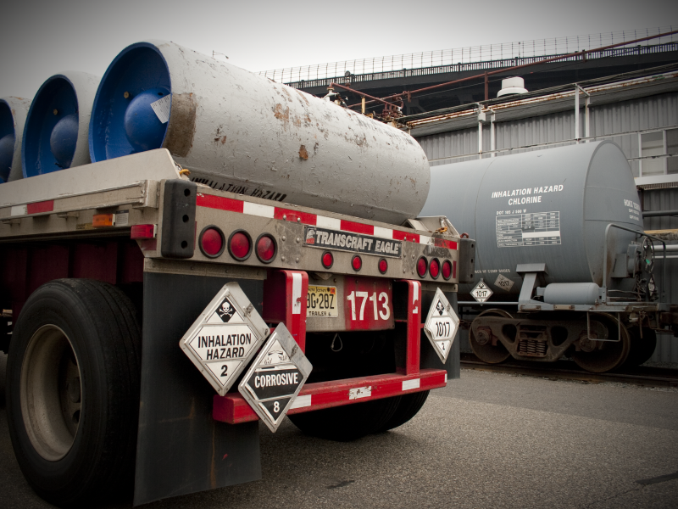
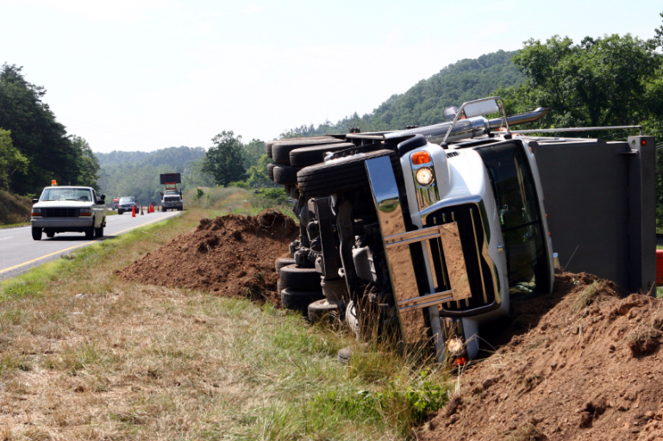
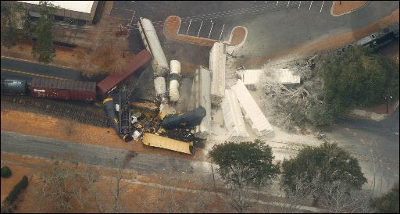
Situation Assessment: Transports
Notes:
31
Assess the situation from a distance. Using binoculars, look for placards, markings and stencils. Assess damage to containers, weather conditions, how the cloud is forming or moving. If it’s a rail incident, look for crossing markers or mileposts and note their location. Look for highway mileage markers to help pinpoint your location.

Slide 32
Product Information
“Loaded” Tank Car
80% liquid full
Pressure 60-100 PSIG
Typical product temperature 50-80º F
“RESIDUE” Tank Car
Residue = 2500 +/- pounds mix of vapor and liquid
Typical pressure 150 PSIG to 275 PSIG
“Residue” is not considered “empty”
Notes:
A loaded tank car will actually only be 80% liquid full. 20% is left for vapor space and expansion of product. A loaded car will have a normal pressure of 60 to 100 psig, and the product temperature should be between 50 and 80 degrees F.
A residue tank car – or a car that contained chlorine, has been off-loaded but may contain residual amounts of chlorine – may contain around 2500 pounds of chlorine in a mix of vapor and liquid. Since there will be much more vapor than liquid, pressure should be between 150 and 275 psig.

Slide 33
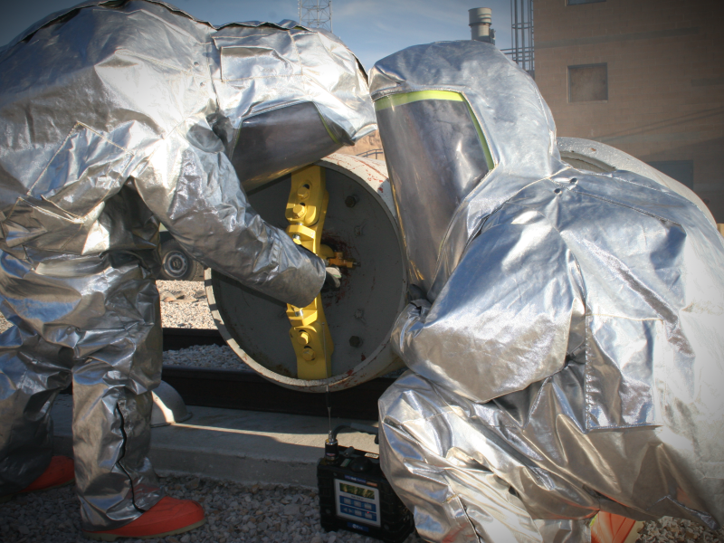
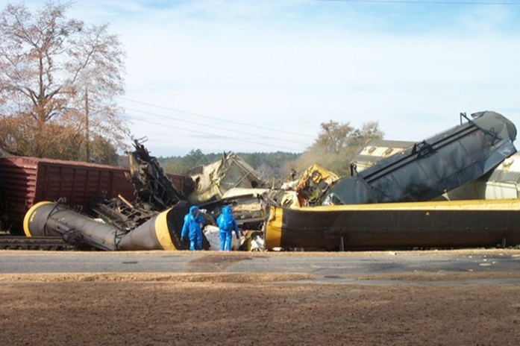
Emergency Response
Focus on containment
First instinct is to throw water on leak, but could make incident worse
Chlorine + water = hydrochloric acid (CORROSIVE!!!)
Water on vessel will raise temperature of chlorine, which will raise pressure and increase vaporization rate
Notes:
33
Of course, the first priority when responding to an emergency is to protect life. But after assessing the incident, the focus should be on stopping the leak and containing the remaining product until it can be safely disposed of or transferred. Your first instinct may be to throw lots of water at the leak point, but as we’ve mentioned earlier, this could actually make matters worse. Chlorine and water can mix to produce hydrochloric acid, which we’ve seen is very hazardous to human and environmental health. And remember the pressure/temperature relationship – water on a chlorine vessel will raise the product’s temperature, which will raise pressure. Do not apply water (unless there is danger of fire impingement).

Slide 34
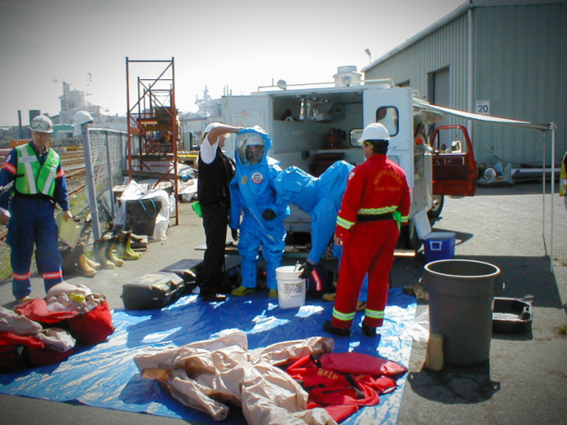
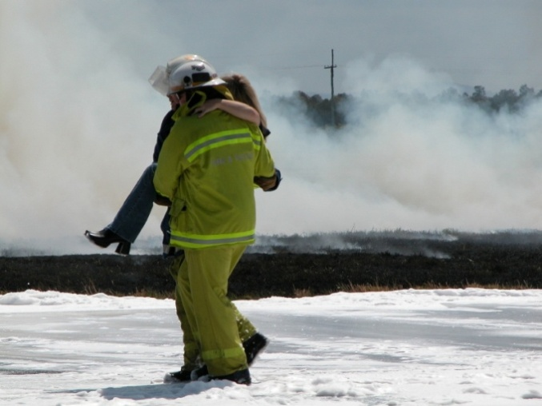
Public Protection Actions: Objectives and Options
Protect public from harm
Protective actions initiated after
Isolation Perimeter is established and
Hazard Control Zones are defined
Tactical options:
Evacuation
Sheltering-in-place
Combination: not mutually exclusive
No clear criteria; a lot of gray areas
Notes:
34
The primary objective of any response is to protect the public from harm. Protective actions can only be initiated after the Isolation Perimeter is established and Hazard Control Zones are defined. The natural instinct to rush in, be the hero and save the victim must be avoided – you could do more harm than good to yourself, your team and the public.
There are three tactical options for safeguarding the public: evacuation, shelter-in-place, or a combination of the two – they are not mutually exclusive and will be dictated by conditions on the scene. Keep in mind there will most likely be no clear criteria, but rather a lot of gray areas when it comes to public safety decisions.

Slide 35
Security Concerns at an Incident
Evidence preservation
Suspicious surroundings and behavior
Notifications - ensure you have identified contacts prior to any incident (who to call and when)
Entry into an incident site
Zones have been established
General alarms and hand signals established
Perimeter security
Hospitals alerted and informed
Notes:
Accidents do and will happen – but we also need to recognize that an incident may be the result of an intentional act. As responders, part of the responsibility of assessing the situation includes being observant about security issues. “Security” at an incident involves two general tasks:
- immediate control of the situation to promote the mitigation of the incident – establishing zones and perimeters, limiting entry into the incident site, establishing general alarms and hand signals, and proper notification of emergency contacts and hospitals;
- and, with a mindset that the incident may have been the act of vandalism or terrorism, evidence preservation, awareness of suspicious surroundings, objects or vehicles and behaviors.
Be observant and report your findings to the proper authorities.

Slide 36
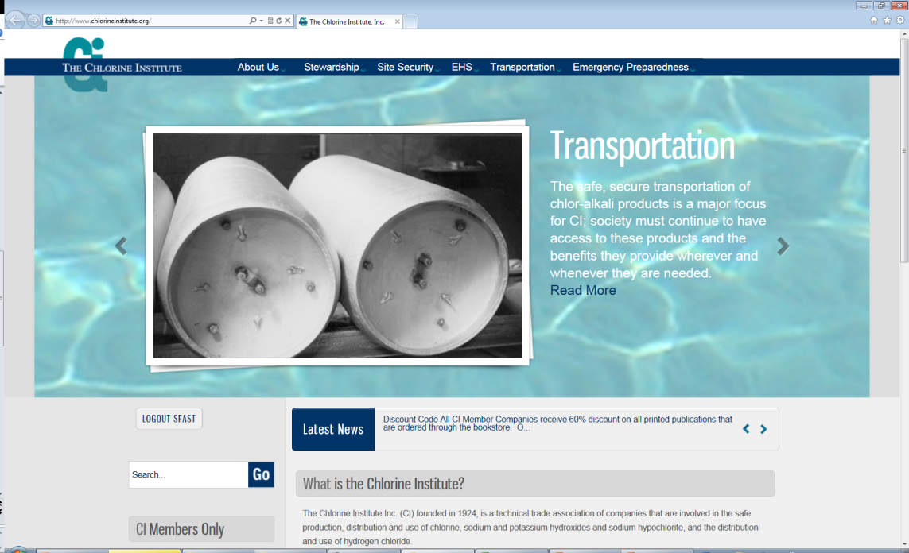
Additional Information & Resources:
CI web site – www.chlorineinstitute.org
Pamphlets
DVDs and online videos
Notes:
36
It is important you have as much up-front knowledge as possible about hazmat incidents and response considerations BEFORE an incident occurs. The more you know ahead of time, the better you will be able to respond and protect. There are many information resources available to you.
Personal networking is one of the most effective – and easiest – way to prepare for an emergency. Take the initiative to get to know the chemical manufacturers, shippers and users in your area. Visit them, take a tour of their facility, become familiar with their people, layout, and procedures and see their transport equipment up close. Ask questions.
There are frequent training opportunities sponsored by industry members where you can get critical hazmat training and hands-on transport opportunities. TRANSCAER is a great resource, not just for chlorine, but for many hazardous materials.
CI’s website is full of valuable information, including pamphlets, checklists and guidelines, as well as professionally produced DVDs and videos.
The more time you can devote to pre-incident education, the better you will be equipped to handle a real emergency.

